Slide 1
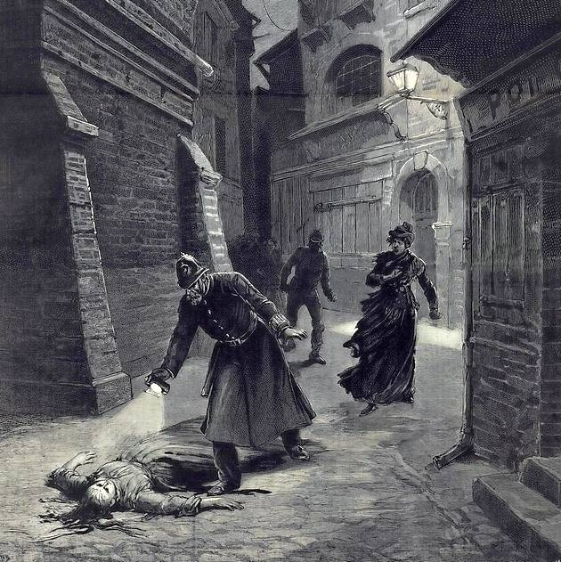
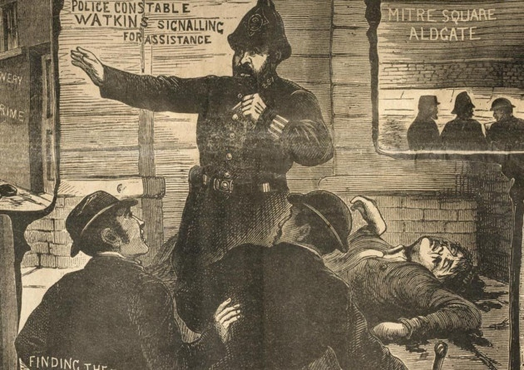
Lesson 1: Whitechapel: The Historical Environment 1870-1900
Background Information
Whitechapel is an area in the East End of London. During the end of the Industrial Revolution, Whitechapel became notorious for its poverty, criminal activity, alcoholism and prostitution. There was widespread unemployment in the area which led to greater poverty. Men would hang around on the gates of factories hoping for enough work to feed their family for the evening.
One survey carried out by shipping owner Charles Booth found out that 35.7% of its residents were living in the worst kind of poverty. Women did not turn to prostitution in the area out of choice, they needed to do this just to earn enough money for their own family.
The police in Whitechapel were run by the London Metropolitan Police. They had to deal with drunken violence, protests, theft and clashes between different immigrant groups. In 1888 they were faced by their biggest challenge. A serial killer known by the press as ‘Jack the Ripper’ carried out brutal murders on vulnerable prostitutes. The national and world press now focussed on Whitechapel and more importantly focussed on the failure of the police to catch the killer.
This topic investigates the environment of Whitechapel, the problems it faced, the killings of Jack the Ripper and the reasons for the failure of the police to catch the killer.
HOW USEFUL ARE SOURCES?
P | Purpose | Why was the source produced at the time? | To entertain, to inform, to promote, to persuade. Was it propaganda? What it intending to highlight a problem? What it to mock or make fun of something or someone?
A | Author Audience | Who has produced the Source? | The government. The police. A court record. A national or local newspaper. An eye witness. An artist/illustrator. The Home Office (Government) document. A policeman. The Home Secretary? Police Commissioner Charles Warren. A cartoonist. It is for the general public? Is it for one person only?
N | Nature | What kind of source is it? | A newspaper report, illustration, letter, diary, set of statistics, interview documents, private memo.
D | Date Description | When was it produced? What does it say (context) | Was it produced before or after an event? Does it tell you about a specific date or a wider range of dates? Does it just tell you about one day rather than a whole year? What is the context of the source? What is it about (topic)? What quote can you use to prove what the source is talking about?
A | Accuracy | Does it fit your knowledge? | How does it match your own knowledge of the time? Is there anything it does not mention that you know about? What do you know that proves it right or wrong?

Slide 2
Lesson 2: Whitechapel: How was Whitechapel policed?
Types of Evidence you could use for an enquiry
The Metropolitan Police
London’s Metropolitan Police Force was set up by Prime Minister & Home Secretary Robert Peel in 1929. London was the first place in the country to have an organised and professional police force. Elsewhere in the country, different towns had their own separate police forces but these were organised by local politicians and ‘Watch Committees’ and were not as well organised at the Metropolitan Police.
Charles Warren
The head of the Metropolitan Police was Charles Warren. His title was Police Commissioner. He had been chosen as he was a former army general and was not afraid to call in the army for support if he needed to. This was the case during the famous Trafalgar Square Demonstrations in 1887. One event known as ‘Bloody Sunday’ had to be dealt with not only by the Metropolitan Police but the army in order to stop the riots spreading. This only led the poor, who were mainly the protestors, to believe the police favoured the middle and upper classes and were not there to protect them.
Type of evidence | Good for what?
Official Home Office Crime statistics | Showing data about the crime rates over certain years, types of crime in an area and how crimes have changed over time.
Statistics from police stations. | Can show information about which officers were on duty, the main areas of crime in the area. How many arrests were made.
Court Records from the main London Court, The Old Bailey | Can show the types of crime being committed, will have evidence of witness statements, police and victim statements. Will include specific information about date, time, names and places.
A ‘Freedom Licence’ | These are the release papers for prisoners which specifically show how long a prisoner was jailed for, the type of crime they committed.
Police memoirs | These are documents, like diaries, written by ex-officers to record their life as a police officer.
Police reports/statements from a crime. | Police Reports are written by the officer as soon after a crime has been committed. They will include information about the location, names and type of crime with eye witness statements.
National newspaper reports | These are useful for showing the bigger problems of crime in an area and can include specific information for an enquiry.
Local newspaper reports | These are useful to find out about smaller scale crimes and they will often give specific names, places and details of the crimes. They can be sensationalist but reflect the attitudes of the public at the time.
Illustrated Police News ( A ‘Penny Dreadful’) | This was a sensationalised paper for the entertainment of the public. It can be very negative and mocking about the police but also highlight important local issues and attitudes.
The Police Review | This was a newspaper set up by the police in order to tell a more accurate version of events to the public.
A Post-Mortem | This provides information about the methods used by a killer and the cause of death of a victim.
The 1881 Census | A government survey of the population numbers and types of housing in areas of the country.
Police numbers
The Metropolitan Police may have been professional, but it struggled to police the whole London area. There were 13,000 men to police a population of over 5 million. To make it worse, only 1,300 of these officers were on shift at any one time. The number of arrests made between 1878-1883 also increased dramatically from 13,000 to over 18,000.
The typical Metropolitan Police Officer
Duties Prevention of Crime and disorder
Carry out foot patrols with another officer (7-10 miles per day)
Expectations:
To patrol a given area called ‘walking the beat’ with another PC.
To write a report of crimes at the end of a shift and to the Police Sergeant at the end of a shift on return to the Police Station.
Character
Law abiding with no criminal record
Willing to use force (when necessary)
Requirements
At least 5 foot 7 inches tall
Fit and in good health
Uniform and Equipment provided *
Blue tail coat and top hat
Truncheon
Handcuffs
Wooden Rattle (to raise alarm of a crime)
*cost deducted from pay.
The Home Secretary
The Metropolitan Police covered the city of London. It reported directly to the government minister in Westminster, London, who was in charge of the police called the ‘Home Secretary’. At first the people of London were very suspicious of the ‘Met’ Police as they believed they were just the government in uniform who would watch their every move and keep an eye on them for negative reasons.
The Criminal Investigation Department
The formation of the Criminal Investigation Department in 1878,
The role of a police constable or ‘PC’ was to be a visible deterrent on the street who could catch criminals in the act and monitor behaviour. However, the Metropolitan Police also began to need individuals to ‘detect’ the perpetrators of a crime. These men were therefore called ‘detectives’. The creation of the CID was a step forward but it was very small and often ineffective. It was set up in 1878 with only 216 officers.

Slide 3
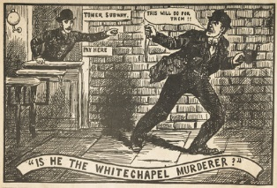
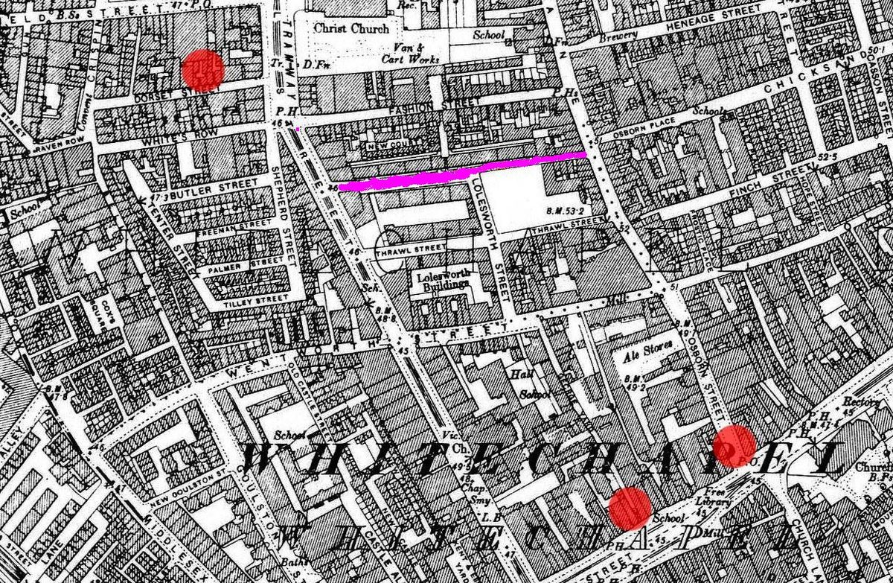
Lesson 3: What were the features of Whitechapel in the 1880s?
The location:
Whitechapel still is a district in the east-end of London. At the time it was the capital’s poorest district. It’s population was around 30,000 with around 1,000 homeless. Londoners shared the district with new immigrants such as the Irish, Jewish and Eastern European immigrants. Poverty, tension between different immigrants groups and high numbers of gangs made Whitechapel a violent area. This was an area where few police wanted to patrol.
WORK/EMPLOYMENT
WAGES:
The average wage for a worker in Whitechapel would be around 25 shillings per week.
BELL FOUNDRY:
Whitechapel’s most famous work place was the Bell Foundry, where Big Ben was made.
SWEATSHOPS:
Sweatshops, where items such as clothing and shoes were made also offered work. ‘Sweatshops’ were small, cramped and dusty and many workers would work for 20 hours a day. Women also found work as ‘match makers’ which they could even do in their home.
DOCKS:
The docks provided work for those men working on the ships. Men would often queue at the start of the day to be given work and sent away if not.
RAILWAYS:
Many Irish immigrants found work building the railways.
WHITECHAPEL ENVIRONMENT
The environment of Whitechapel itself led to higher crime rates. Streets were narrow, unlit and often over-crowded, even late at night.
The noise, smell from pollution and the famous London ‘smogs’ (thick fogs) would often make a quick escape from a crime scene easy.
The streets were interlocked and maze like with very few street signs. The over-crowding made minor crimes such as pickpocketing easy.
It was a heavily polluted industrial city where sanitation (public health) was very poor with very little clean drinking water.
UNEMPLOYMENT
There was high unemployment because of an economic depression at the time. Even fewer jobs were available to women. This meant many turned to prostitution as the only way to earn money and survive.
Often, with nothing else to do, boredom would lead to high levels of alcoholism, disruptive behaviour and violence.
HOUSING/ACCOMODATION
ROOKERIES: Most houses were in over-crowded ‘slum’ areas known as ‘rookeries’ which included dirt, disease and crime. Houses were split into several apartments with up to 30 people sharing beds.
POPULATION: The 1881 census puts the population of Whitechapel at over 30,000 but with only 4,000 houses.
LODGING HOUSES: These were for those who were even poorer. They offered a bed in dirty, squalid conditions. They even had shifts for sleeping so the beds could be used by the most number of people. It was estimated that there were 200 Lodging Houses in Whitechapel for more than 8,000 people.
COFFIN BEDS &HANGOVERS: Some people were so poor that they had to rent either a ‘coffin’ bed for the evening or even lean up against a ‘two-penny hangover’ – a rope tied from one end of the room to the other.
The Peabody Estate
Improved housing was created. In 1875 the government created a new law called the Artisan’s Dwelling Act. This law, cleared away some of the slum areas and replaced it with 11 new blocks of flats.
They were paid for by George Peabody who was a wealthy American who had moved to London and wanted to improve the conditions for the poor. The Peabody Estate opened in 1881 and provided 286 flats for a reasonable rent of 3 shillings per week.
THE WORKHOUSES
For those with nowhere to live and living in absolute poverty, the one last place was the workhouse.
They offered food and shelter for the promise of hard work. Those that were not able to work such as the old, sick, disabled, orphans were called ‘inmates’.
The work was made deliberately difficult to put people off ever having to work there. They were expected to live under strict discipline, were separated in to men and women and even punished for talking to each other.
VIOLENCE AND TENSION
Over-crowding, poverty and high immigrant numbers led to tension between different groups.
High numbers of prostitutes made women vulnerable to violence.
When the ‘Jack the Ripper’ murders were taking place in 1888, it was easy for different groups to blame each other. E.g., there was an increase in Anti-Semitism as locals blamed the Jews.
ORPHAN CHILDREN
Due to the poor hygiene and many poor social situations, there were a high number of orphans (children without parents) in Whitechapel. These children would normally get sent to the workhouse or sold on to other work.
However, thanks to the work of Dr Thomas Barnado, some children were given an education and shelter in various orphanages. In 1870, he opened up an orphanage for boys and later for girls.
By 1905, he had opened 100 Barnado's Homes in London. The famous motto above the door of an orphanage was ‘No destitute child ever refused admission’.

Slide 4
Lesson 4: Immigration and tensions within Whitechapel
Why was there tension between the residents of Whitechapel?
During the later 1800s, London had received an influx of immigrants from around Europe. Many moved to London seeking a better life and to escape poverty or discrimination in their own country. However, with so little money, they ended up having to find the cheaper areas of London to live in. Whitechapel was near the docks which made it the first place they came across after their journey. However, they soon faced discrimination from the longer term residents of Whitechapel and then with each other. A mixture of cultures, religions, languages and beliefs led to rising tensions. All of this made Whitechapel even more difficult to police.
Immigration | Irish | Irish Fenians | Jewish | Socialists & anarchists
There was a greater mix of immigrants which led to tensions between the locals, Irish, Eastern Europeans & the Jewish. Overcrowded areas of Whitechapel brought immigrants very close to each other and they found it difficult to mix. Tension was often fuelled by alcohol within the Irish community in particular. A Parliamentary Committee was even set up to investigate the rising tensions between the Eastern Europeans & the English. Conflict often started in mixed race, run down areas. The local newspapers were also to blame for spreading a fear of ‘foreigners’ as they named some Jews as suspects to be Jack the Ripper. | There were greater numbers of Irish since the 1840s. Many planned to use their work in London to raise enough money to migrate to America. However, many could not raise the money so stayed in the East End and Whitechapel instead. The Irish men had jobs such as buildings canals, roads and railways, dock yard workers. The Irish were not well liked. They were known for their drunken behaviour and violence. | The Fenians were an Irish Catholic group who were seen as a terrorists in London. They wanted Ireland to have freedom from the UK and they organised bomb attacks on London landmarks known as ‘Dynamite Saturday’ Huge anti-Irish and anti-Catholic attitudes spread by the press because of this which led to even more racist attitudes by the locals. The Police set up a unit called the Special Branch in response to the Fenians to keep watch on them. | Many Jews moved to the East End due to violence against them in Eastern Europe and Russia. Jews segregated themselves into particular areas of Whitechapel and did not mix with locals. Locals were jealous of how quickly Jews found work (they would work for lower wages). Many Jews ran tailoring businesses (making clothes) that employed poor working class Londoners who did not like having a ‘foreign’ boss. Jews worked on a Sunday as Saturday was their Holy Day – this made local businesses suspicious. Cultural differences with clothes and food made the Jews ‘stand out’ as different. There became a strong Anti-Semitic attitude towards the Jews. Stereotyped by the press. Beatings & attacks on Jews were common. | Revolution attempts to bring down the government by ‘Anarchists’ in Europe failed but made people in England were fearful that anarchists in London might do the same. It was believed that many anarchists from Eastern Europe had moved to the East End. Locals therefore believed that anyone with a European accent could be an anarchist and so treated all foreigners were fear and suspicion. Socialists wanted more equality for the working classes with better pay. The Social Democratic Federation (SDF) was the first Socialist political part in Britain. It organised protests and demonstrations by the poor. E.g. Bloody Sunday/Trafalgar Square Demonstrations.
THE MAIN FEATURES OF THE TENSION
There was tension because of the competition between immigrants and local people for housing and jobs. Each group blamed the other for a lack of work and cheap accommodation. This could easily lead to violence under the influence of alcohol.
Racist attitudes towards the Jews, Irish and Eastern Europeans existed within the police. They were often seen to accuse an immigrant for a crime with no evidence.
Jewish workers were willing to work for lower wages and eventually began to run their own ‘sweatshops’ employing local people. This led to tension between the locals and the Jews.
It was easy for the longer term locals to blame ‘foreigners’ for any crimes and violence. For example, the Jack the Ripper murders were often blamed on Jews. This caused racial hatred and violence.

Slide 5
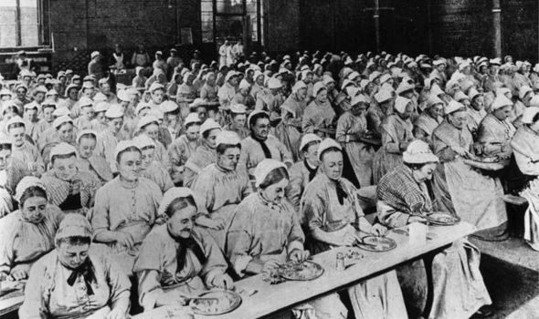
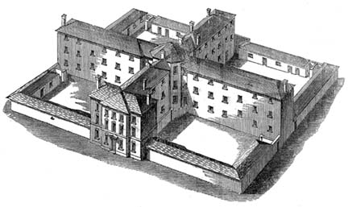
Lesson 5: The features of the Whitechapel Workhouses
What were the conditions like in a workhouse?
Workhouses were based on the plans of a prison. The people in a workhouse were even called ‘inmates’.
Inmates would be separated into areas for women, men, girls and boys. Each workhouse would also have an infirmary to care for the sick.
The conditions in a workhouse were deliberately made strict, physically tough and demanding with punishments such as beatings for those that did not follow the rules.
Even talking to another inmate during work hours could be punished. They were made like this to deter more people from using the workhouse and encourage as many as possible to seek work. This meant the workhouse was the last possible resort for anyone.
The inmates would have to wear a uniform and families in the workhouse would be split up.
What were ‘workhouses’?
Workhouses were buildings set up by the government in the early 1800s. The government needed a way to support the increasing number of poor in Britain’s growing cities. They were a way of providing ‘Poor Relief’ to those that could not work. They provided basic shelter, food and water in return for work.
Workhouses in Whitechapel
Due to the increasing amount of poverty in the East-end of London, Whitechapel had an above average need for the workhouse.
What type of people ‘lived’ in the workhouse?
The people in a workhouse would be the very poorest in society.
They included:
Those too old or sick to work,
Persons with a physical disability who could not work or be looked after by family.
Orphaned children.
Unmarried mothers who had been disowned by their families.
How long would people stay in a workhouse?
Those without work in Whitechapel might stay for 1 or 2 nights only. However, other inmates would be in the workhouse longer term, often for months.
What work did the ‘inmates’ do?
The work for all inmates was physical hard labour. Some inmates would be asked to break up rocks, others might pick out old rope or make matches.
What was the hygiene like?
Workhouses were dirty and cold. Food was prepared for the inmates but would be very basic. There would be basic bathroom facilities and each area would have an open yard for exercise.

Slide 6
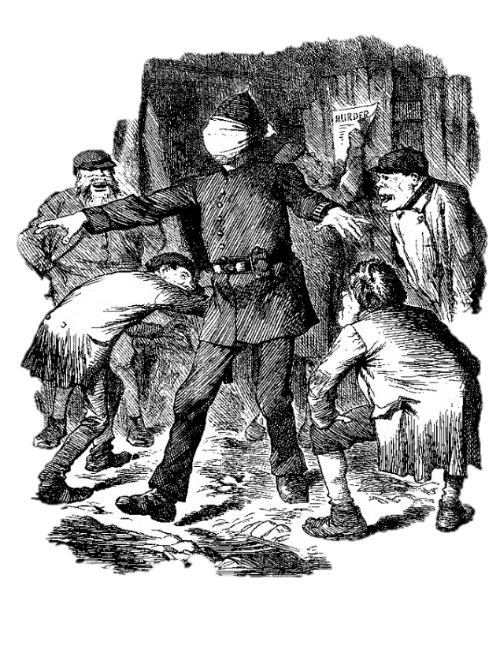
Lesson 6: What were the difficulties of policing the Whitechapel Community?
The background information
The Metropolitan Police were divided into 20 divisions, one for each area of London. Whitechapel was covered by H Division. Each ‘Division’ was organised under a superintendent and a chief inspector. Under this level were the 37 sergeants. Each sergeant supervised on average 500 ordinary ‘beat’ constables or Police Constables. This was a very organised system for the time. However, the location of Whitechapel made the everyday policing of it very difficult for the officers. The reasons are divided below.
The daily routine and behaviour of the Police Constables
Alcohol
Officers would walk to the area where they were expected to patrol. This was called ‘walking the beat’. They were expected to patrol an area & act as a deterrent but also speak to the locals to gain information. Any events would be written down in a police diary.
Some constables avoided their beat if it was in a particularly dangerous area and some drank alcohol while on duty.
As the work was very boring at times, some officers might even be caught idly chatting or even asleep. The pay for the constables was poor and so the quality of recruits to the police was poor. Some sergeants had to follow constables to keep an eye on them.
Alcoholism was common amongst the poor and unemployed. It was their only escape from their terrible lives. It was very strong but also very cheap. On the main Whitechapel road there were 45 pubs or gin palaces. Opium Dens were set up by Chinese immigrants and provided another cheap. Drunken behaviour was common. Many residents of Whitechapel were difficult to deal with, there were many violent crimes and thefts caused by alcohol.
Protection Rackets
There were powerful gangs in Whitechapel. They made agreements with local businesses to protect them. Businesses could be smashed up if they disagreed. There was also violence between the gangs. People were afraid to report gang violence as they feared they would be attacked in revenge. It was almost impossible for the police to collect evidence to arrest gang members.
Local Attitudes towards the Police
The Metropolitan Police were created in 1829 and in most parts of London, they gained respect and were known as the local ‘Bobby’.
However, in poorer areas of London such as Whitechapel, the police were still seen as a form of government who were just trying to control and watch over them, rather than help with their problems. When protests broke out at Trafalgar Square, the police were criticised for being too ‘heavy handed’ & beating protestors with truncheons.
The police in Whitechapel were seen in a negative light and often criticised.
Attacks on police officers by locals and gangs were common.
The role of the Police in Whitechapel
The Police by the 1870s had a huge responsibility not just for crime but also for dealing with ‘social’ issues such as litter, sewage, runaways and even making sure dogs were muzzled in public places. This meant the few police had even more to do. It also meant they were criticised for not fighting crime but just dealing with ‘social work’. If they had to control prostitutes they were given a hostile reception by the women. This could also mean they were not taken seriously by the public.
Prostitution
The environment of Whitechapel
Many crimes in Whitechapel were linked to poverty and unemployment. It was
harder for women to find work and many became prostitutes to survive.
Women would work on the streets or in brothels. Either of these would leave the women vulnerable to attack as they were alone, often at night. It was not illegal at the time but was still a social problem that the police were expected to deal with. Women might become pregnant, and illegal abortions might be performed.
It was estimated that there were 62 brothels in Whitechapel with 1,200 prostitutes.
Women would rarely want to help the police as they feared the consequences. Often, prostitutes would also be drunk and so being able to recall an incident accurately would also be a problem.
Many Whitechapel Streets were poorly lit at night. There were very few signs in dark and narrow alleys where criminals could escape quickly. Whitechapel suffered from terrible ‘smogs’ which meant visibility could be very poor and this made seeing a crime or catching a criminal even more difficult. Streets could be crowded and noisy during the day.
The Local Press/newspapers
The local press gave little sympathy towards the police. They often mocked the police for not being able to catch criminals, especially the case of Jack the Ripper in 1888. This influenced further public attitudes towards the police and led to fewer people wanting to help them.

Slide 7
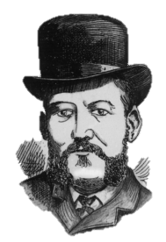
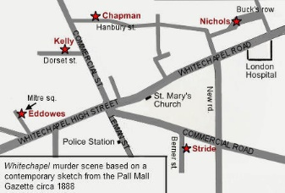
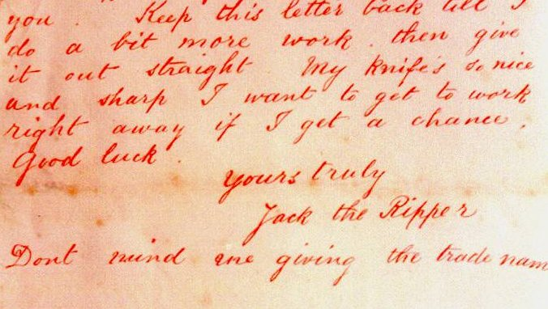
Lesson 6: How the Metropolitan Police dealt with the Jack the Ripper Murders of 1888.
The background information
Whitechapel, during the 1880s was a violent and unpredictable place. Murders were not uncommon and the police would be often called to deal with violent or drunken attacks against women. However, a series of attacks that took place in Whitechapel during 1888, highlighted the problems faced by the police and the limits of the methods used at the time to catch criminals. Police believed that at least 5 women were killed by the same ‘serial’ killer who was given the popular nickname ‘Jack the Ripper’ by the local press.
The main victims.
Historians have argued that at least 5 prostitutes were victims of ‘Jack the Ripper’ although the number may be higher.
Mary Ann Nichols (found in Buck’s Row on 31st August)
Annie Chapman (found in Hanbury Street on 8th September)
Elizabeth Stride (found in Berners Street on 30th September)
Catherine Eddowes (found in Mitre Square also on 30th September)
Mary Jane Kelly (found in Dorset Street, on 9th November)
What made the investigation more difficult?
Public Involvement
The police will often seek help from the public for information. However, such was the publicity and panic about the murders that over 300 letters and postcards were sent to either the police or the local newspapers by men claiming to be the killed. The letters all had to be followed up which took time and men away from investigating further. Most of the letters were fake and this was a huge waste of police resources.
Police Force Rivalry
One victim, Catherine Eddows was killed just on the border between the Metropolitan Police and the City of London Police. Charles Warren wanted to make sure the murder was investigated by the Metropolitan Police and so ordered vital written evidence to be removed from Goulston Street which was just inside the City of London Police territory.
Who was in Charge of the Jack the Ripper case?
The Metropolitan Police Commissioner Charles Warren, placed Inspector Frederick Abberline and his CID team in charge of the Jack the Ripper Case. They supervised officers of H Division. Abberline was an experienced officer with a detailed knowledge of the area.
The local Media
Newspapers, especially the sensationalist Penny Dreadfuls made the most of the murders with dramatic images of the victims and wild speculation about the murders. This whipped up public emotions further and put more pressure on the police. Journalists were quick to jump to their own conclusions on poor evidence or unreliable eye witness accounts. Many press articles were keen to accuse the killer of being ‘foreign’, and published articles which accused the killer of being Jewish. This led to further tension in the area.
Removal of Evidence
The evidence removed from Goulston Street was writing, in chalk on an alleyway wall. It read ‘The Juwes are the men that will not be blamed for nothing’. Commissioner Warren was worried that any mention of blaming the Jews for the murders would led to even more anti-Semitic tension in the area and so ordered officers to wash it off. This could have been a vital piece of evidence.
The Modus Operandi (method of killing).
Detectives were able to link the murders using what is known as the Modus Operandi (MO for short).
All victims were female
All victims were prostitutes
All victims were targeted at night
All victims likely drunk
All victims killed using a sharp blade of a knife.
All victims stabbed multiple times
All victims left at the crime scene
Most victims mutilated.
An extract from the letter sent to the police signed ‘Jack the Ripper’. This is how the killer got the nickname.
How did the local press help the investigation?
The Metropolitan Police were able to use the newspapers to appeal to the public for information about specific murders. For example, a famous letter sent to the police called the ‘Dear Boss’ letter, was copied into newspapers in the hope that someone would recognise the handwriting.

Slide 8
Lesson 7: The techniques used by the police to investigate the murders.
The background information
The police used a variety of methods. In this lesson, you will find out what the methods were, how they helped and their limits.
Public information and eye Witnesses
Police were given some ‘leads’ (useful evidence) by the public. This was importance as the public of Whitechapel would often know more then the police about the area. Leads had to be followed up but could be very misleading and wasted a lot of time. The public would make suggestions based on their own prejudices such as racism and their fear of local gangs. There were few people who claimed to be eye witnesses to any of the murders.
Soup Kitchens
The police were not allowed to offer money as a reward. This was standard practice as it would lead to even more time wasters just wanting money in such a poor area. However, the police encourage poor people to come forward with information by promising them a hot meal and a warm drink. Most just came for this but offered nothing else.
Visiting Lunatic Asylums
As the murders were so savage, the police believed that Jack the Ripper would be ‘insane’ (mad). They therefore visited several lunatic asylums in the area to see if any of the inmates had escaped. However, this led to no information and no inmate would have been capable of carrying out such an ‘accurate’ set of cuts on the victims.
Officers in Disguise
The police were running out of ideas and so came up with a plan to dress some of their (male) officers up as prostitutes. The idea was to catch the killer in action by using the officers as bait. This only led to the police being further mocked by the local police and the press.
Post Mortems
This was a detailed examination of a person’s body ‘after death’ to find clues about the cause of death. The doctor suggested that the cut marks on the bodies were that of someone who was left handed and with some knowledge of human anatomy (biology). This led the police to investigate local doctors, hospitals, vets and even 76 butchers. Post Mortems could be useful but with little scientific equipment could also be unreliable and unclear.
Sniffer Dogs
The police had started to understand the ability of some dogs to sniff out suspects. Barnaby and Burgho were two bloodhounds who were trained in London’s Hyde Park. These trials were successful. However, the dog’s owner refused to allow the dogs to be used in Whitechapel as the police refused to pay him. This meant, the dogs were never actually used in Whitechapel, despite some newspapers creating amusing illustrations of them doing this. Again, the police were mocked for their techniques by the police.
Police Techniques
Information from journalists
Many local and national journalists were quick to solve the murder themselves with their eye on a good story. Locals would be happier talking to journalists rather than the police and so they often collected a lot of information. One suspect known only as ‘Leather Apron’ was named by the press and led the police to investigate. However, journalists were too quick to jump to their own conclusions or not share information with police. They were more interested in the story, not the truth.
Victim’s Possessions
Items found on or near the victim’s body would be used as evidence about a possible murderer. For example, an envelope left near the body of Annie Chapman had links to the army. This was investigated but nothing more came of it. Jewellers were contacted about victims jewellery. It was possible this could provide clues about the victims but Whitechapel was that dirty and untidy that most of the objects would be simple litter.
Public information after 30th September
After the evening of the double murder, the Metropolitan Police increased their methods with house to house searches, questioned people more than 2,000 lodging house residents, distributed 80,000 police notices and questioned the sailors in the docks who might be trying to hide the killer. Queen Victoria and even international newspapers also became involved at this time by demanding even more change to the way the police were investigating the murders.

Slide 9
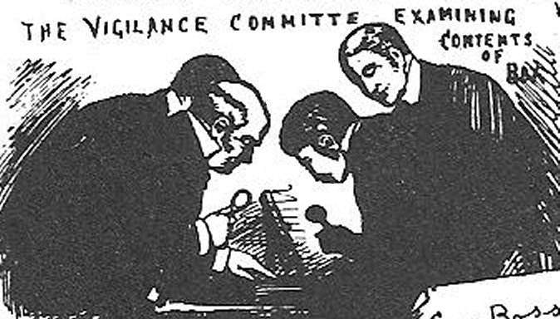
Lesson 8: What were the obstacles to the Police Success catching Jack the Ripper?.
The background information
The Metropolitan Police were able to use a number of investigating techniques that were commonly used at the time. When they were not able to catch Jack the Ripper however, they had to resort to much more unusual techniques for the time such as ‘undercover’ officers and the use of sniffer dogs. At this time, more scientific and ‘forensic’ methods were very limited. Even if they were seen to work, not all forces and officers would trust the new techniques. This was another obstacle to the success of the police.
The restriction of police methods used at the time.
The Whitechapel Vigilance Committee
SCIENTIFIC METHODS:
The Metropolitan Police had almost no scientific methods to help them solve a crime. Their only hope was to catch the killer in the act.
FINGER PRINTING:
It would be another 12 years before finger printing was accepted as a method to detect criminals and used as reliable evidence. Police officers at the time knew about this as a technique but would have not believed it or taken it seriously enough.
BLOOD ANALYSIS:
Scientists were not able to detect the difference between human and animal blood. There was no way of knowing a person’s blood type either. With such mess and pollution in Whitechapel, any number of blood samples would be found on the streets from butchers shops, slaughter houses, drunken attacks and injuries.
DATEBASE COLLECTIONS:
There was no ‘data-base’ or collection of photographs available of known criminals in the area for police to use. Police forces did not often share information with other forces in the country. A criminal in the H Division area of Whitechapel could easily move to another part of London controlled by the City of London Police and not be known.
PHOTOGRAPHY:
Crime-Scene Photography was only just beginning to be used to record evidence. The quality was poor and often, only the body would be photographed rather than the whole crime scene which might lead to more evidence.
OLD BELIEFS:
Some older officers still believed that photographing the eyes of a victim might record the last image they saw in the reflection of their eyes. The older officers were very reluctant to any type of change or scientific methods which could have helped.
LACK OF EXPERIENCE:
The police in Whitechapel had never had experience of such crimes before. The mutilation of at least 5 women was a shock for them as well as the local community. They had little experience and no training about how to deal with such investigations.
Who were they?
A group of businessmen and traders in Whitechapel were so frustrated with the lack of police progress after the killing of Mary Ann Nicholls, that they set up their own ‘Vigilance’ group. Vigilantes are groups that take on the responsibility of tackling crime themselves because they believe the official police force are not able to do so as effectively. They would often contradict the methods and official policies of the Metropolitan Police.
Giving a Reward
The Metropolitan Police did not want to offer a reward for the capture of Jack the Ripper as they believed it would lead to time wasters and false leads. However, the leader of the Whitechapel Vigilance Committee, George Lusk, was willing to offer a reward.
What did they do?
They took to the streets night after night, armed with burning planks of wood, whistles and hob-nailed boots. They hoped to drive out the killer or catch him in the act. They also wrote to the government to complain about the lack of protection being given to the local people, so they also set up their own nightly patrols. They met every evening in The Crown pub and after closing time went out patrolling the streets.
‘From Hell’ Letter
One key event for the Vigilance Committee was when George Lusk was sent a letter and a parcel, apparently by the killer. The letter is known as the ‘From Hell’ letter and the parcel contained half a human kidney. This was linked to the killing of Catherine Eddowes.
More police criticism
They were determined to embarrass the police, stir up local feeling further and put pressure on the government to do more to catch Jack the Ripper. The Vigilance Committee certainly led to the sensationalist newspapers of the time having an even greater number of stories to criticise and mock the police.

Slide 10
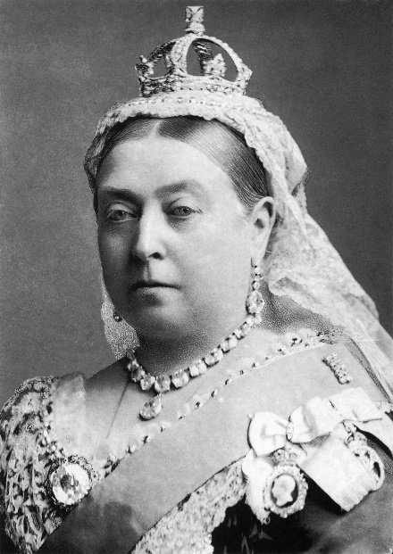
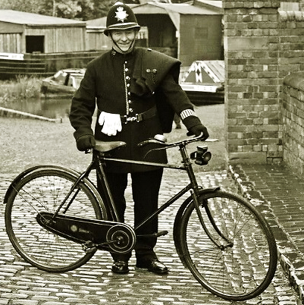
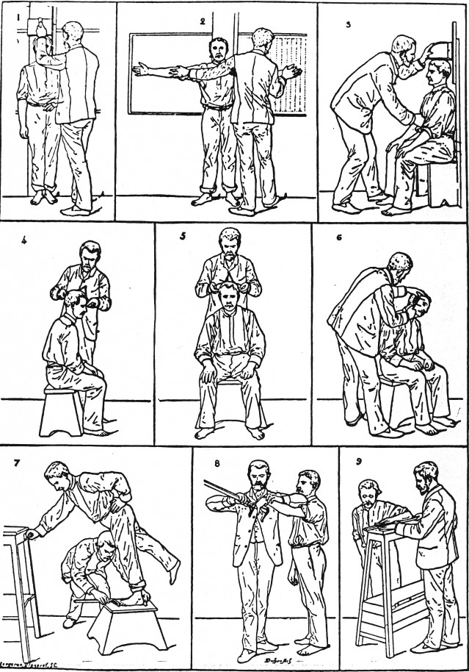
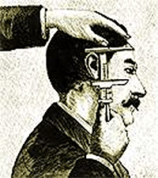
Lesson 9: What improvements were made to policing and the Whitechapel area after 1888?
The background information:
With such a huge amount of pressure on the Metropolitan Police to solve the mysteries of the murders, it was no surprise that such a violent set of events also led to pressure for change in the local environment of Whitechapel. Queen Victoria became personally involved in the investigation. She sent two telegrams with her own practical advice. She said that dark passageways should be lit and for passenger and cattle ships to be searched at the local docks. There were even some rumours in the press that the Royal Family themselves were in some way linked with the murders but this was never proven.
Improvements in Police Record Keeping
The failure of the police to catch Jack the Ripper, led to a review of how the police kept records of criminal behaviour. The result was the use of the Bertillon System in 1894.
This was one of the first ways that information about criminals was collected by the police. Suspects and criminals would be measured in a variety of ways then a ‘mug-shot’ (photograph of the head and shoulders) taken to be kept in the same centrally stored file. This information would then be shared with different divisions if needed.
Improvements in Communication
The only form of effective communication in Whitechapel in 1888 was the use of the whistle which could call for support if needed. However, by the 1900s, the Met were starting to use the new telephone lines. H Division did not use a telephone to the station until 1901. Bicycles were also starting to be used by some police forces by 1896, but again H Division waited until 1905 to make use of its first bicycle.
Overall, despite the public outcry about the Jack the Ripper murders and the pressure put on the police, it seemed they did not learn from their failings or take on new forms of technology and transport to help their police work further.
Knowing a suspect’s measurements and image would help eye witnesses identify suspects in the future. It would help catch criminals who repeated their crimes and who were known to the police.
Improvements in the Whitechapel Environment
There was a great change in how the police saw the causes of crime and the link between crime and poverty in places such as Whitechapel. The government began to improve health and housing in the district as well as introduce more lighting to the dark slum areas. The Jack the Ripper murders led to two key changes in law:
The Houses of the Working Class Act (1890):
This led to the removal of the poor slum areas with newer housing developments which would be low cost for the poor to afford to live in. These houses included better sanitation and hygiene with improved living conditions.
The Public Health Amendment (Change) Act (1890):
This gave power and money to local councils to improve toilets, paving, rubbish collection and other sanitation services in poorer areas such as Whitechapel.
Not all good news!
There were no more serial killings but murders in these areas continued regularly in the 1890s. Hooliganism increased, especially with young people pretending to be Jack the Ripper frightening women. There was more recorded violence against prostitutes and an increase in burglary in the early 1890s.
Bertillon’s photographic methods are still used today and they were the first method of centralised record keeping in the country. Measurements were later added to with unique finger printing details.

