Slide 1
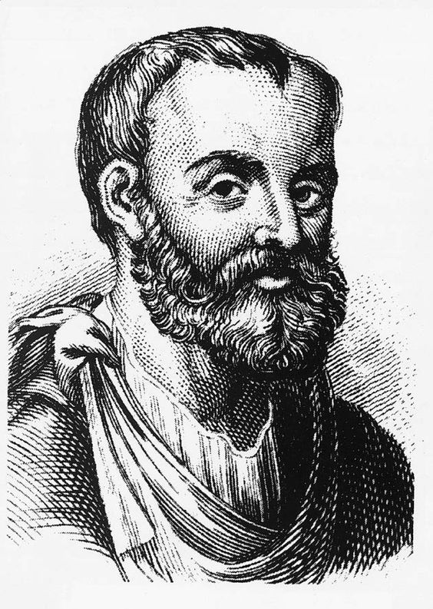
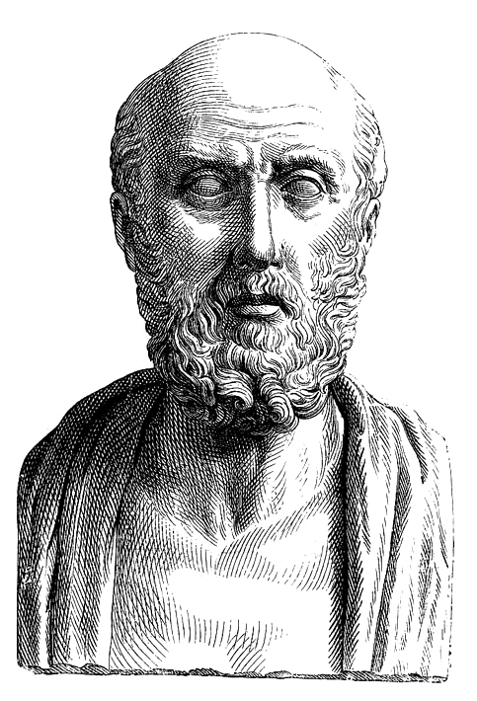
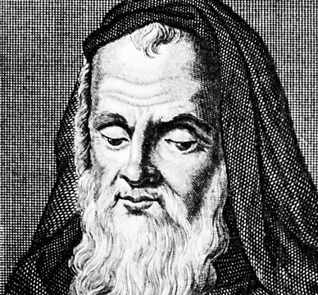
Key Dates:
1278 – Roger Bacon imprisoned by the Church
1348 – The Black Death arrives in Britain
1470s – The printing press arrives in Britain
GCSE History Knowledge Organiser: Medieval Medicine, 1250-1500
Physicians learned from Galen’s work
God sends disease to punish humanity
Church supports Galen’s ideas
Dissections on humans rare – only carried out to prove Galen correct
→
Church
Education
Books copied out by hand
King’s main duties – upholding law, defending the country
REASONS FOR LACK OF CHANGE IN MEDICINE
Government
People reluctant to question traditional ideas
Conservative Attitudes
Individuals
?
Taxes not spent on public health
Fear of Hell
Hippocrates
Galen
Roger Bacon

Slide 2
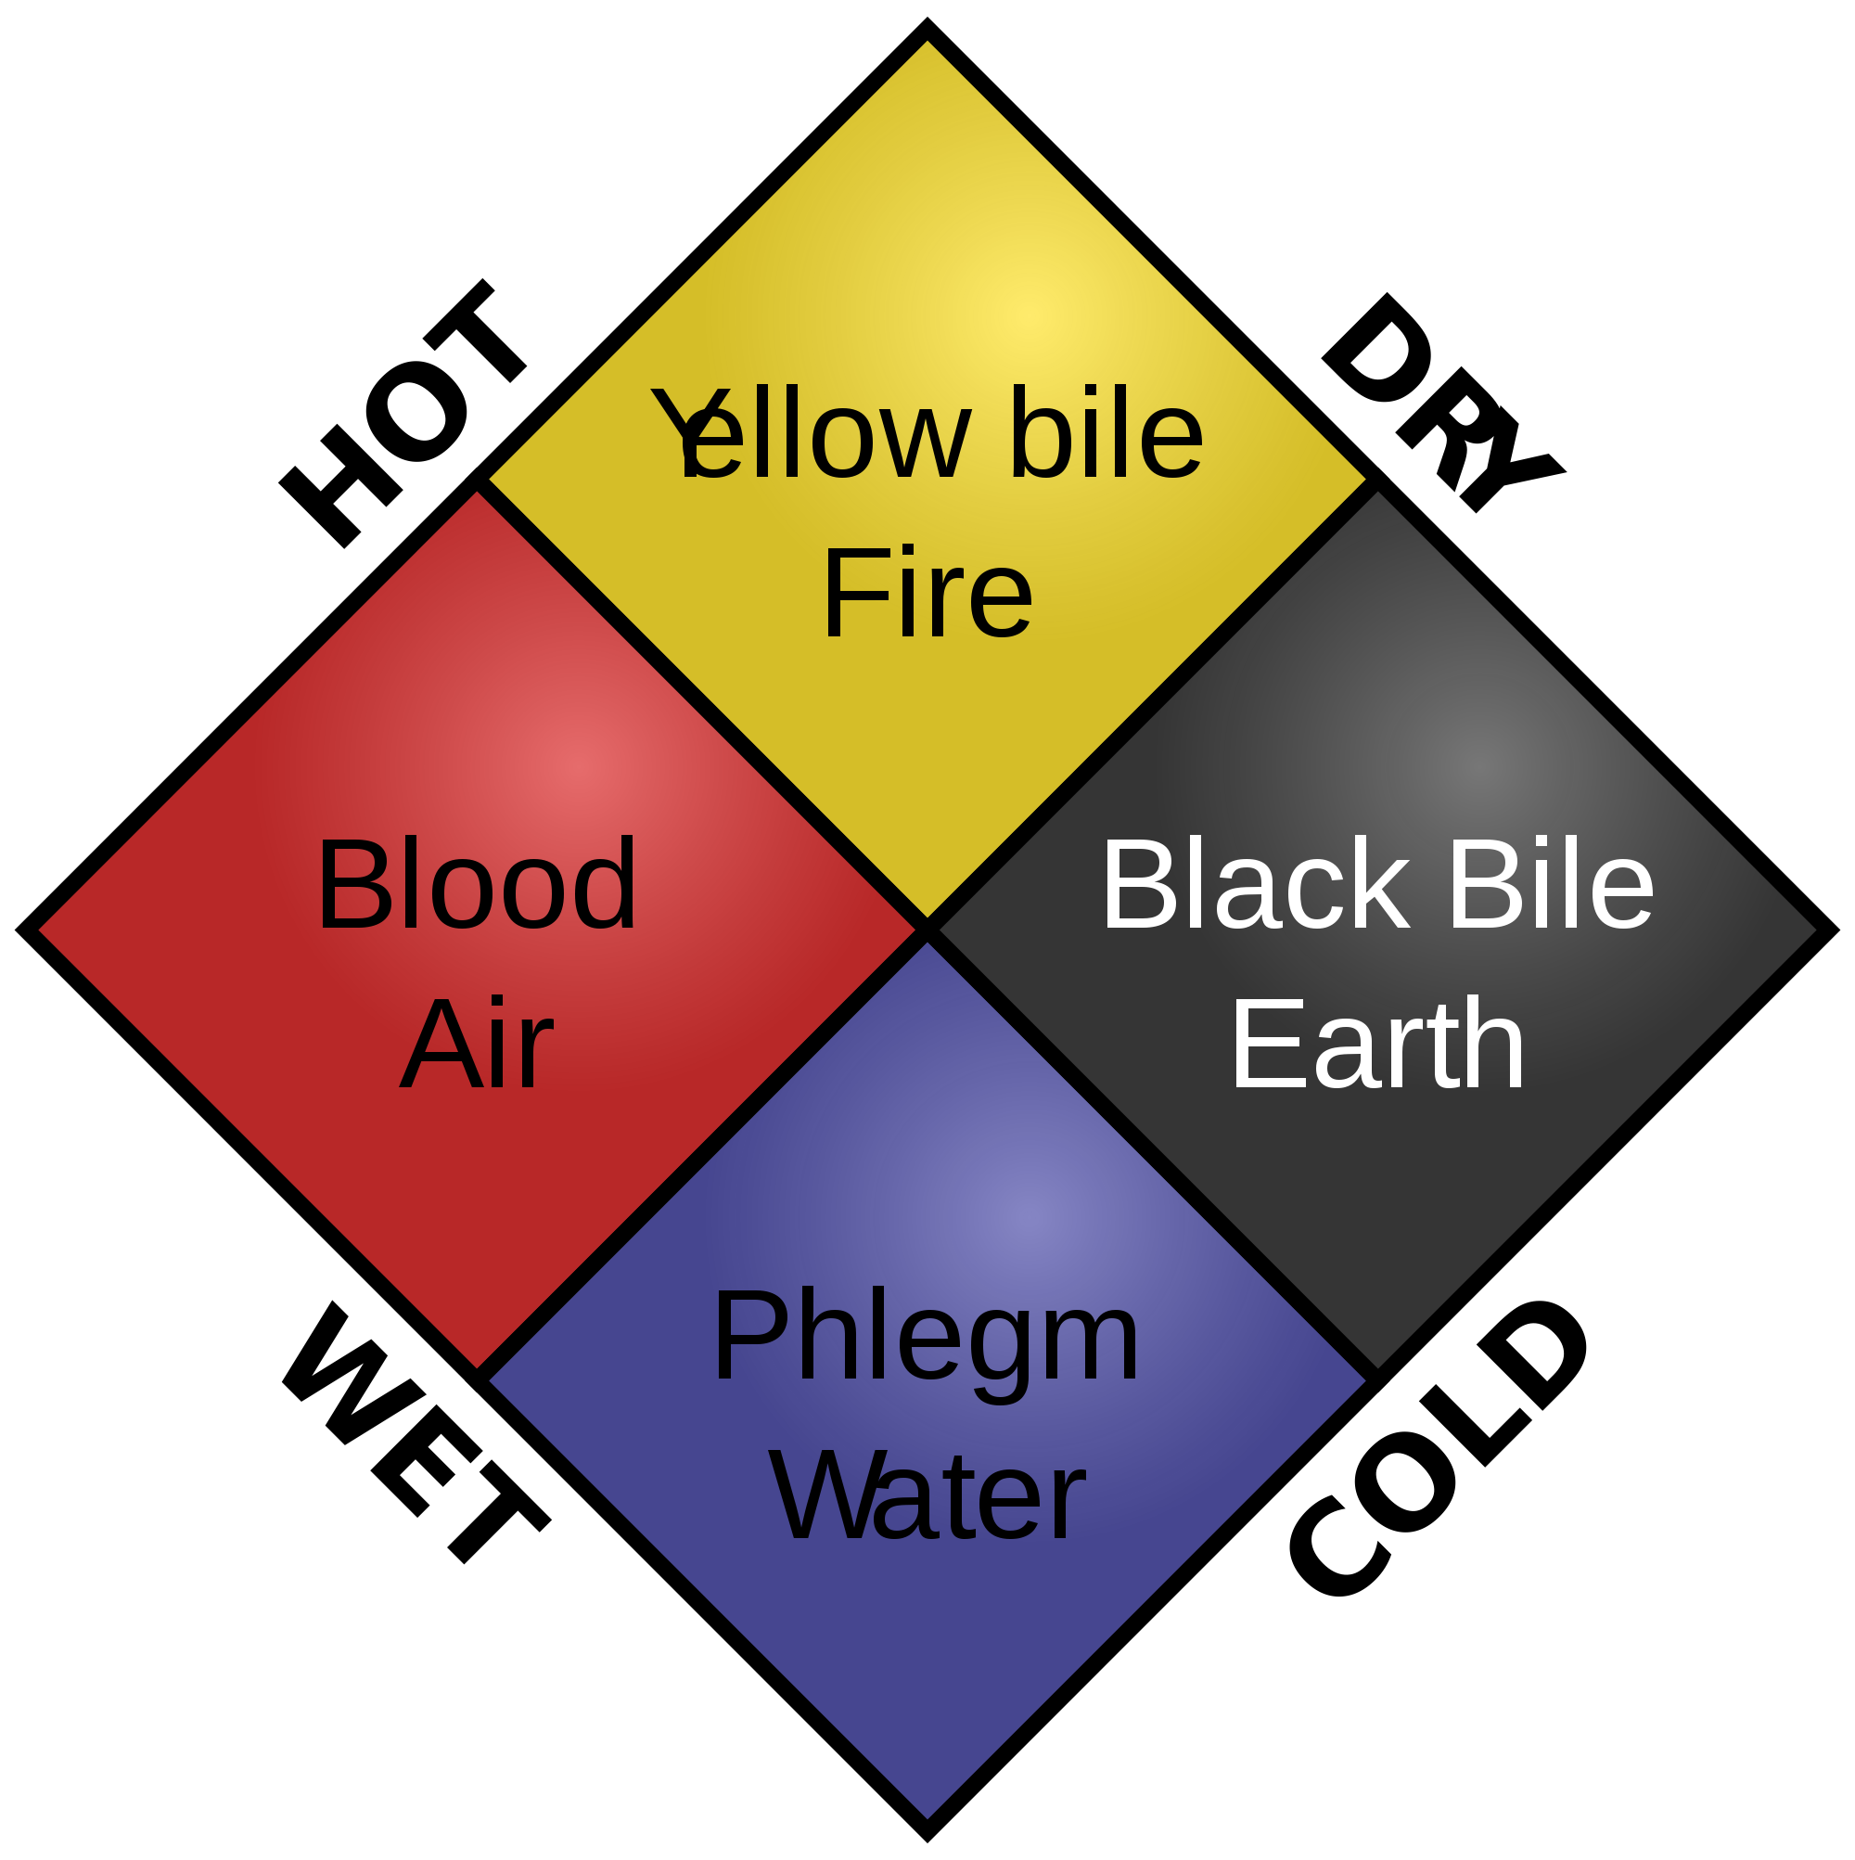
Keywords:
Miasma:
Bad air that was believed to cause sickness
Four Humours:
The theory that imbalanced humours caused sickness
God’s Punishment:
The belief that people became sick because God punished them for their sins
Flagellants: People who whipped themselves to show God they were sorry
Rakers:
People paid to sweep towns’ streets
Regimen Sanitatis Instructions given by physicians for keeping healthy: included moderate exercise and not over-eating
GCSE History Knowledge Organiser: Medieval Medicine, 1250-1500
HEALERS IN THE MIDDLE AGES
Physician
Apothecary
Barber Surgeon
Women
FEATURES OF MEDIEVAL MEDICINE
CAUSES
=
God’s Punishment
Imbalance of Humours
Miasma
TREATMENT AND PREVENTION
Posies
Incense
Rakers
Prayer
Fasting
Flagellation
Bloodletting
Purging/ Laxatives

Slide 3
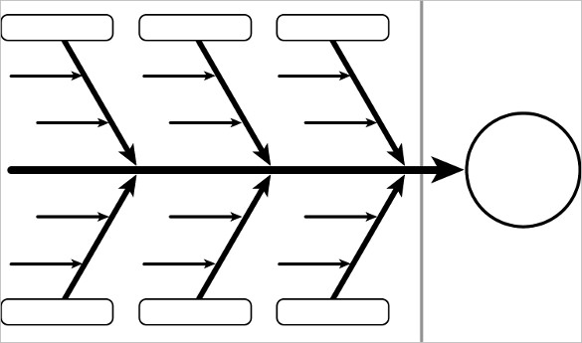
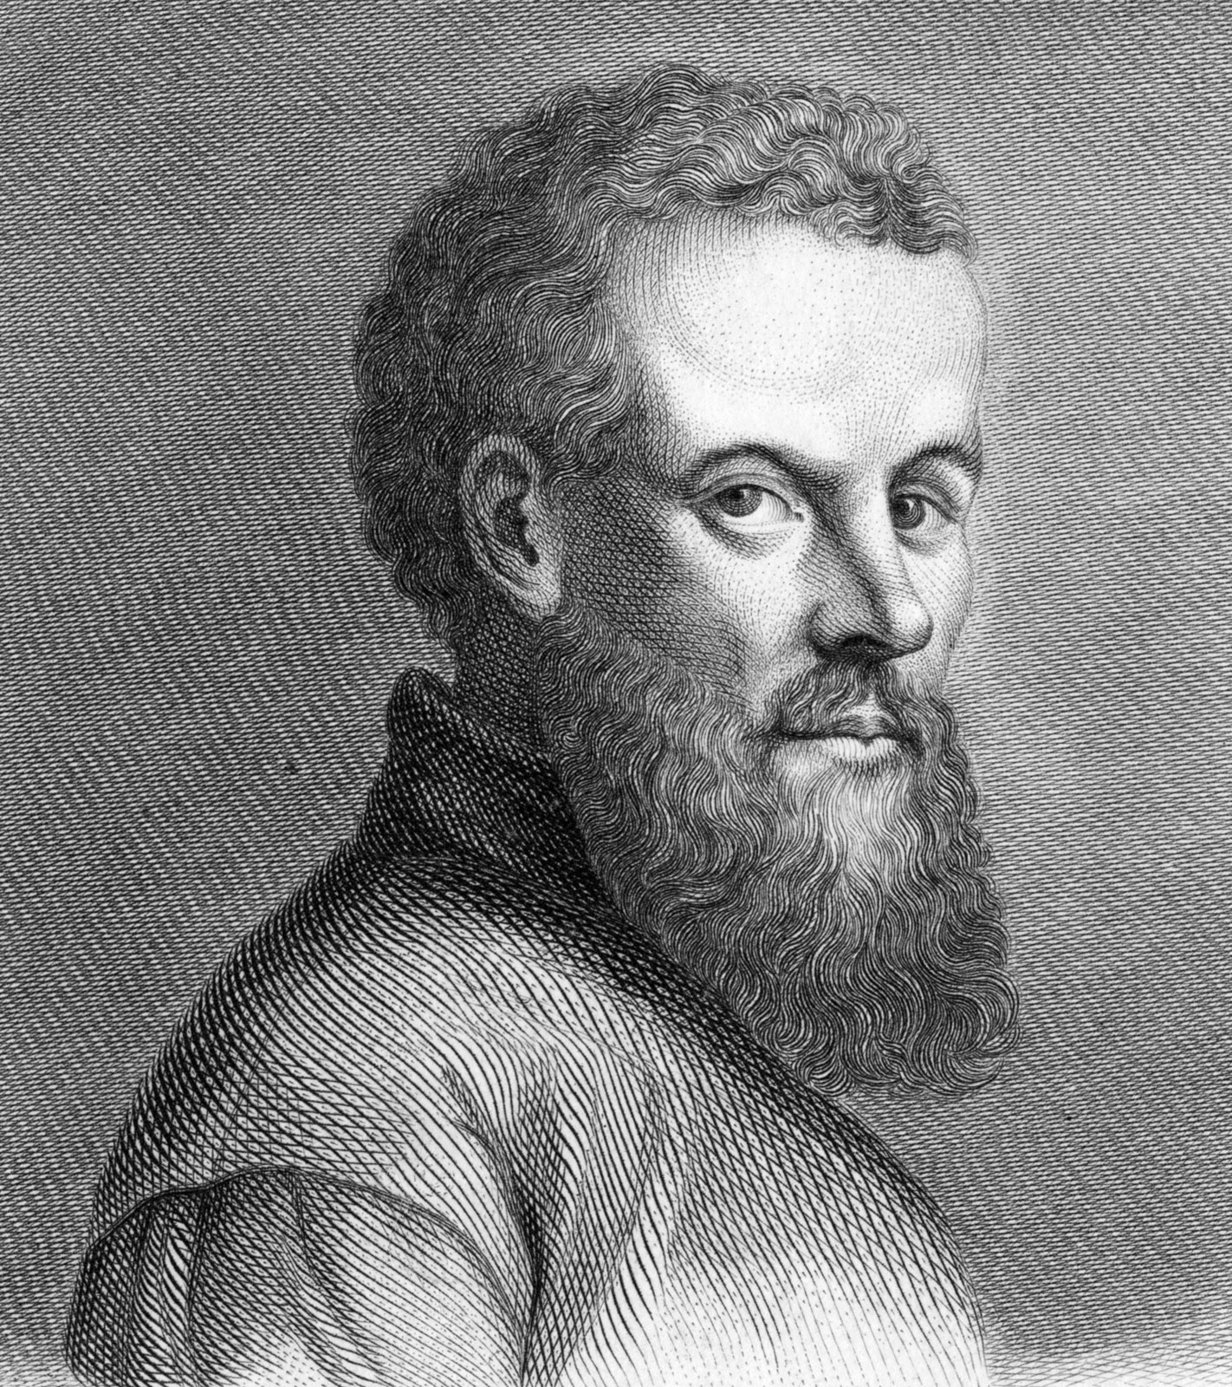
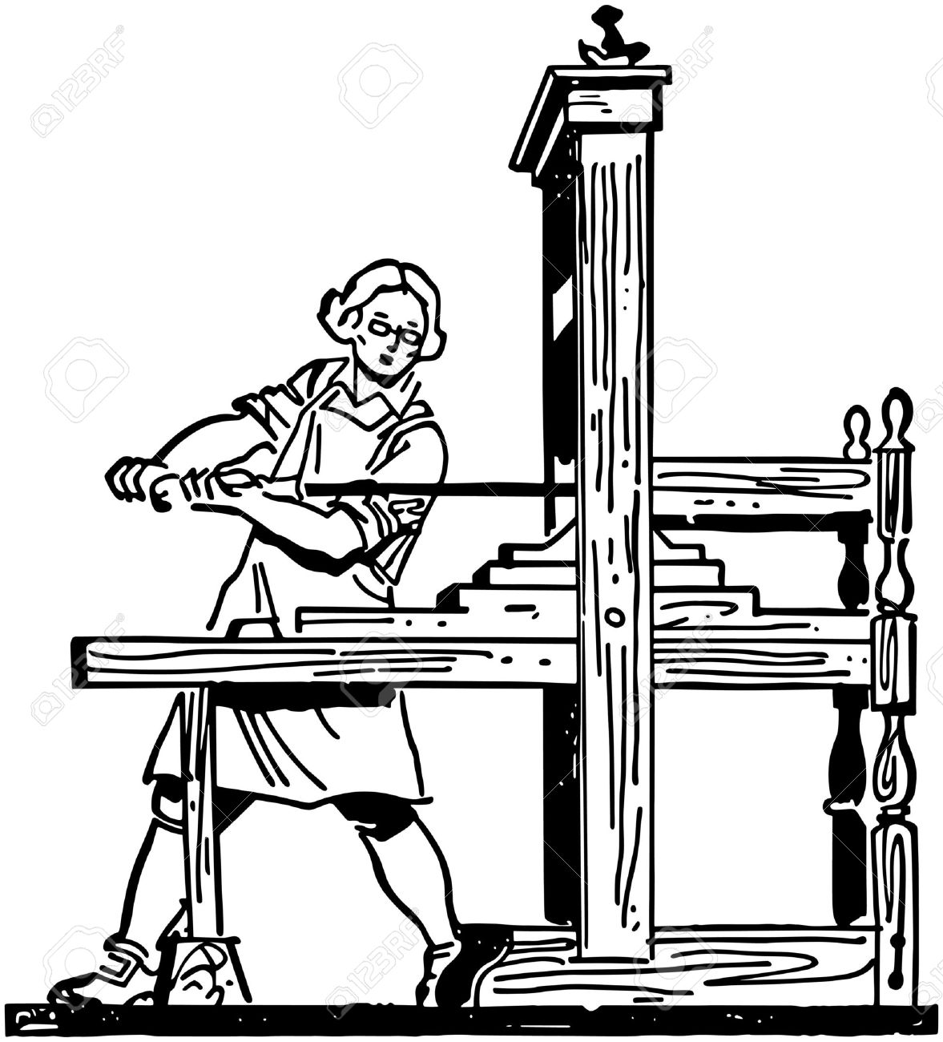
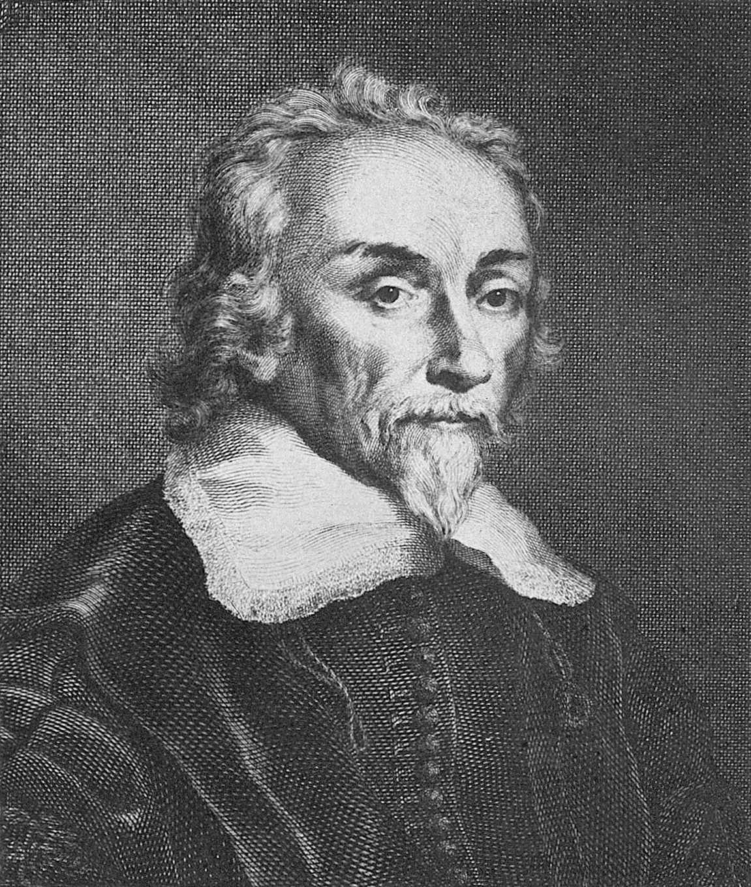
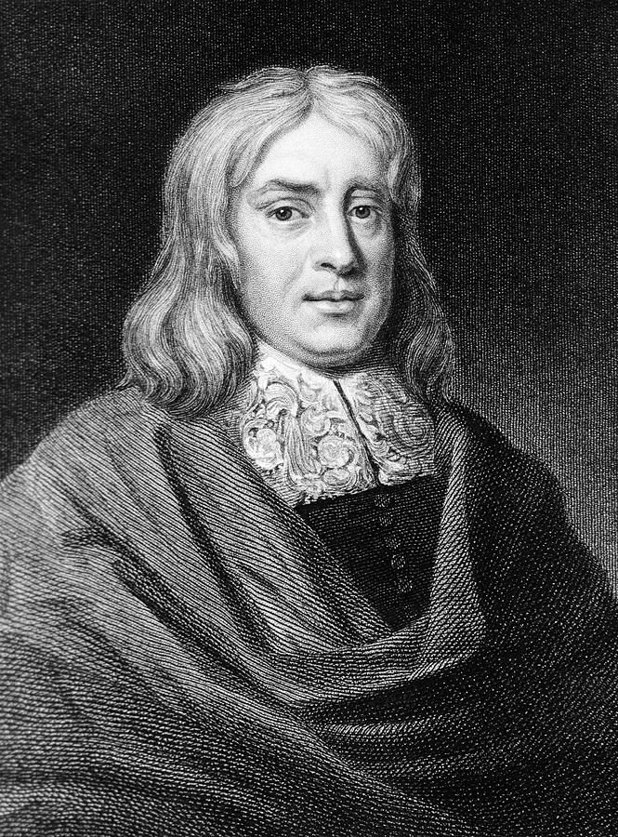
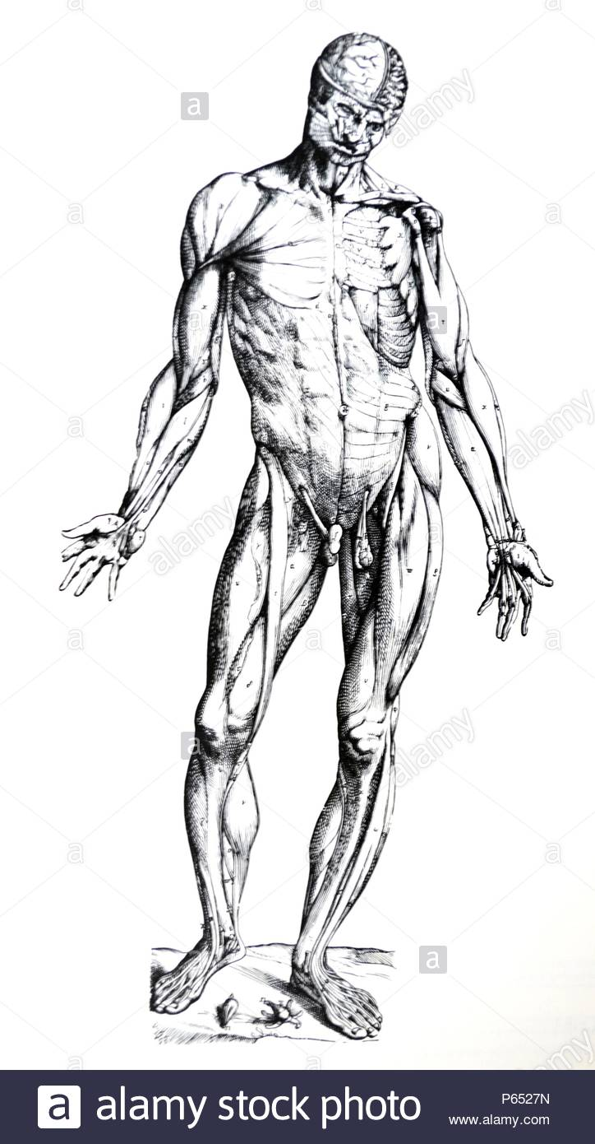
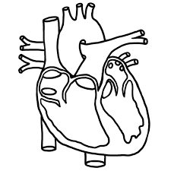
Key Dates:
1470s – The printing press arrives in Britain
1543 – Vesalius publishes Fabric of the Human Body
1628 – William Harvey publishes his work on the circulatory system
1660 – The Royal Society is founded
1665 – The Great Plague in London
1676 - Thomas Sydenham publishes Observationes Medicae
1683 - Anton van Leeuwenhoek discovers bacteria but nobody realises their significance
GCSE History Knowledge Organiser: Renaissance Medicine, 1500-1700
Individuals
Progressive Attitudes
Technology
Andreas Vesalius
Public dissections
Printing Press
Royal Society
Mechanical Pumps
William Harvey
Thomas Sydenham
Scientific Method
Why was there progress in medical knowledge BUT continuity in treatment and prevention?
God’s Punishment
Continuing respect for Galen’s ideas
=
Four Humours
Miasma
Influence of the Church
Anatomical discoveries did not further understanding of causes
Lack of Knowledge
Conservative Attitudes

Slide 4
Keywords:
Miasma:
Bad air that was believed to cause sickness
Four Humours:
The theory that imbalanced humours caused sickness
God’s Punishment:
The belief that people became sick because God punished them for their sins
Phlebotomy: Bleeding a patient whose humours are unbalanced
Rakers:
People paid to sweep towns’ streets
Plague Doctor Doctors who specialised in the plague. Their ‘beaks’ were stuffed with lavender
GCSE History Knowledge Organiser: Renaissance Medicine, 1500-1700
HEALERS IN THE RENAISSANCE
Physician
Apothecary
Barber Surgeon
Women
FEATURES OF RENAISSANCE MEDICINE
CAUSES
=
God’s Punishment
Imbalance of Humours
Miasma
TREATMENT AND PREVENTION
Plague Doctor
Burning Tar
Tobacco
Prayer
Fasting
Pilgrimmage
Bloodletting
Purging/ Laxatives

Slide 5
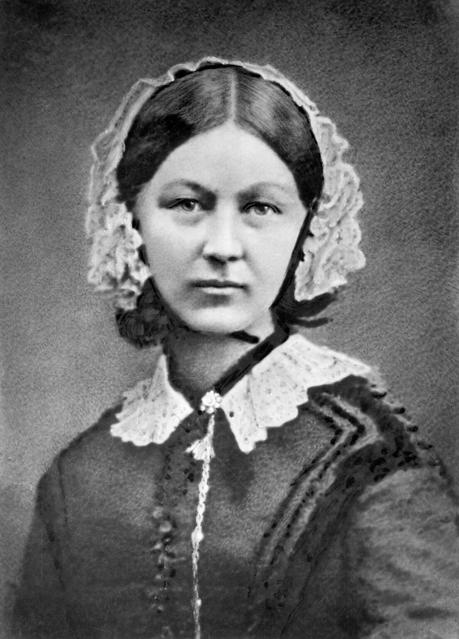
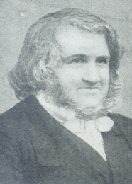
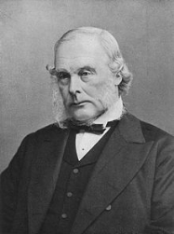
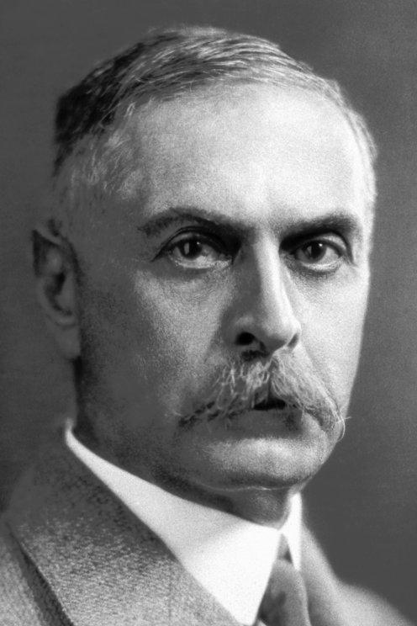
Keywords:
Anaesthetic:
Chemical to induce sleep
Antiseptic:
Fighting infection
Ligature:
For tying up or binding a wound
Carbolic Acid:
Used to clean equipment and theatres
Transfusion:
Transferring blood to another person.
GCSE History Knowledge Organiser: Improvements in Surgery and Nursing, 1700-1900
Ligature
Blood Transfusions
Blood Groups
1842 - Ether
1847 – Chloroform
1848 – Snow realises chloroform needs careful administration
Disinfecting hands and clothes
Blood loss
Pain Relief
IMPROVEMENTS IN SURGERY AND NURSING IN THE INDUSTRIAL PERIOD
Carbolic Acid Spray
Nurse training
Infection
Nursing
Hygienic practice
Sterilising surgical equipment
Notes on Nursing (1859)
Florence Nightingale
James Simpson
Joseph Lister
Karl Landsteiner
Notes:
Ligature, blood transfusion, blood groups
Carbolic Acid – hands and spray, Sterilisation

Slide 6
Keywords:
Miasma:
Theory of “Bad Air”
Cholera:
Waterborne disease
Bacteriology:
Study of micro-organisms
Inoculation:
‘Live’ bacteria used to create anti-bodies
Vaccine:
Weakened version of bacteria to create anti-bodies
GCSE History Knowledge Organiser: Growing understanding of the Causes of Disease in the Industrial Period
1796
1854
1861
1882
1885
Edward Jenner
John Snow
Louis Pasteur
Robert Koch
Louis Pasteur
Developed Germ Theory, encouraged government to make smallpox vaccines compulsory
Discovered vaccine for Smallpox, making inoculation obsolete
Proved cholera transmitted by dirty water
Bacteriology, used chemical dyes to identify bacteria
Developed a vaccine for rabies, led to vaccines for other diseases

Slide 7
Keywords:
Laissez-faire:
Idea of non-interference by government
Pension:
Money from govt for those 65+
National Insurance:
Part of workers wages went to guarantee sick pay
Welfare State:
Govt using tax money to look after various groups in society.
NHS:
Abbreviation for National Health Service
GCSE History Knowledge Organiser: Improvements to Public Health in the 19th and 20th Centuries
Public Health Act – councils could…
Appoint a local medical officer
Provide clean water
1848
1858-1865
‘Great Stink’ in London (1858)
Joseph Bazalgette built 1,300 miles of sewers in London by 1865
Second Reform Act
Increased the number of men who could vote in elections
1867
Provide clean water
Dispose of sewage properly
Inspection of new houses
Public Health Act – councils had to…
1875
1906 – Free School meals
1908 – Old Age Pensions
1911 – National Insurance – Sick pay and maternity benefit
National govt led
New Liberal govt focus = people
1910’s
NHS formed –
Based on Beveridge Report (1942)
1948

Slide 8
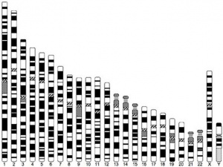
Keywords:
Magic Bullet
A chemical treatment that kills bacteria
Antibiotics
A drug made from bacteria that kills other bacteria and so cure an infection
DNA
The genetic ‘instructions’ that determine how your body works and looks
National Health Service
Provides healthcare in Britain which is free at the point of delivery for all
GCSE History Knowledge Organiser: Growing understanding of the Causes of Disease in the 20th century
Germs
1909
1928
1941
1955
Paul Ehrlich and Hata
Alexander Fleming
Florey and Chain
Jonas Salk
Penicillin is trialled on a policeman, with some success and then mass-produced
Developed a polio vaccine
Created first magic bullet, Salvarsan 606
Fleming identifies penicillin in his lab
Genetics
1951
1953
1990s
Rosalind Franklin
Crick & Watson
Human Genome Project
Images of DNA created by using x-ray crystallography
Discovered the double-helix structure of DNA
Human genome mapped
Lifestyle
1901
1942
2007
Seebohm Rowntree
William Beveridge
Parliament/ Public Health England
Proved a link between poverty and disease
Beveridge identified 5 ‘giants’ to be defeated – ‘Want, Disease, Ignorance, Squalor and Idleness’
Smoking in public places banned

Slide 9
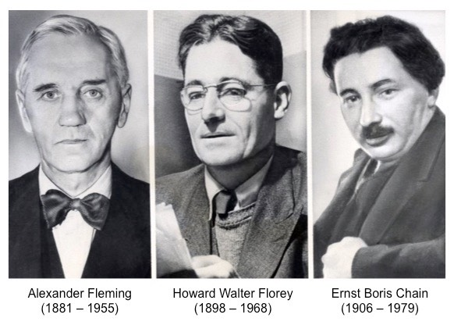
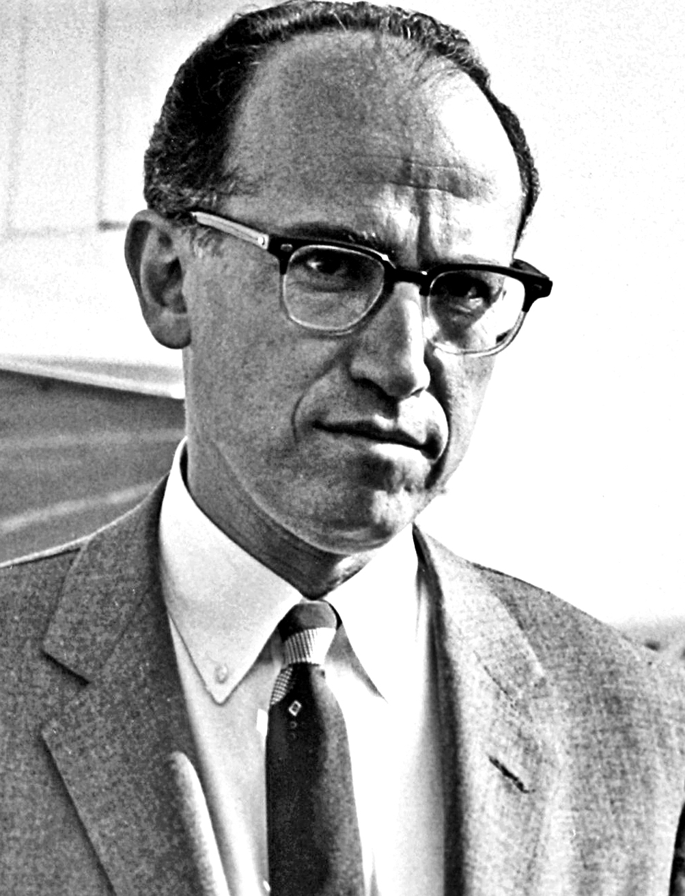
Keywords:
Mass Production:
The production of large numbers of items using assembly lines
Penicillin:
An antibiotic drug used to treat a number of infections
Endoscope:
A flexible camera used to see inside the body
Radiotherapy and Chemotherapy:
Cancer treatments based on nuclear science
GCSE History Knowledge Organiser: Reasons for Rapid Progress in Medicine in the 20th Century
Government
Technology
Individuals
Mass Production
Fleming, Florey and Chain (pencillin)
Scans and monitors
Jonas Salk (polio vaccine)
Huge government spending on health
Why was there rapid progress in treatment and prevention during the 20th century?
International community of scientists
People wanted a better future after war
…of Germ Theory
Collaboration between scientists
…of genetics and DNA
Need for penicillin during war
…of the impact of lifestyle
Attitudes
Knowledge
War

Slide 10
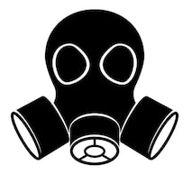
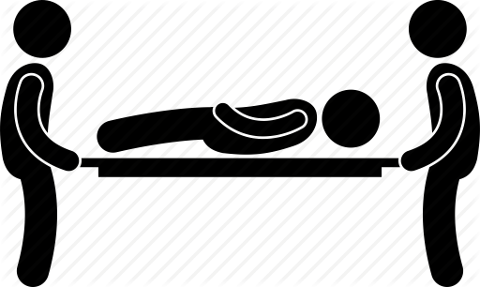
Key Dates:
Autumn 1914 – First Battle of Ypres
Spring 1915 – Second Battle of Ypres
1916 – Battle of the Somme
1917 – Battle of Arras
1917 – Battle of Cambrai
GCSE History Knowledge Organiser: Surgery on the Western Front, 1914-1918
Shrapnel Wounds
X-Rays
Carrel-Dakin Method
60
Disfigurements and Burns
Head
Plastic Surgery
Trench Fever
Improvements in Treatment
Injuries
World War I, 1914-1918
Blood Bank/ Transfusion
Trench Foot
Gas
Thomas Splint
Skin Grafts
Fractures
The Evacuation Route
Stretcher Bearers
Regimental Aid Post
Field Ambulance and Dressing Station
Casualty Clearing Station
Base Hospital

