Slide 1
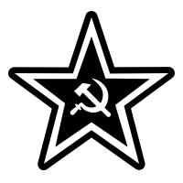
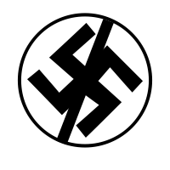
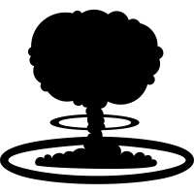
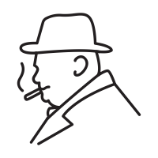
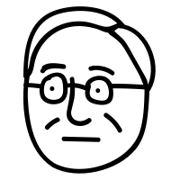
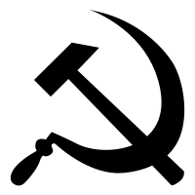
The Wartime Conferences, 1943-45
Grand Alliance
The alliance between the US, USSR and UK that defeated Nazi Germany in WW2
D-Day
The Allied invasion of north-western France in June 1944
United Nations
An international organisation set up to preserve world peace
Reparations
Compensation for damage caused during the war
Oder-Neisse Line
Part of the German-Polish border than ran along the Oder and Neisse rivers
Red Army
The army of the Soviet Union
Nov 1943
Feb 1945
Aug 1945
The Tehran Conference
The Yalta Conference
The Potsdam Conference
GB and USA agree to open up a second front by invading France in summer 1944
USSR to attack Japan once Germany defeated
UN to be set up after war
Borders of post-war Poland to be moved westwards.
Germany and Berlin would be divided into four zones
Declaration of Liberated Europe – countries liberated from Nazi rule would have elections
Eastern Europe would be a Soviet ‘sphere of influence’.
Confirmed decision to divide Germany and Berlin into four
Germany to be demilitarised, democratised, de-Nazified
Germany to pay reparations to Allies – most of which to go to USSR
Poland’s border with Germany to be moved to the Oder-Neisse Line.
BUT – disagreement on amount of reparations and the exact location of the German-Polish border.
BUT – disagreement on how harshly Germany would be punished, and on free elections in Eastern Europe.
Josef Stalin
1922-1953
Franklin D. Roosevelt
1933-1945
Clement Attlee
1945-51
Harry S Truman
1945-1953
Winston Churchill
1940-1945, 1951-55

Slide 2
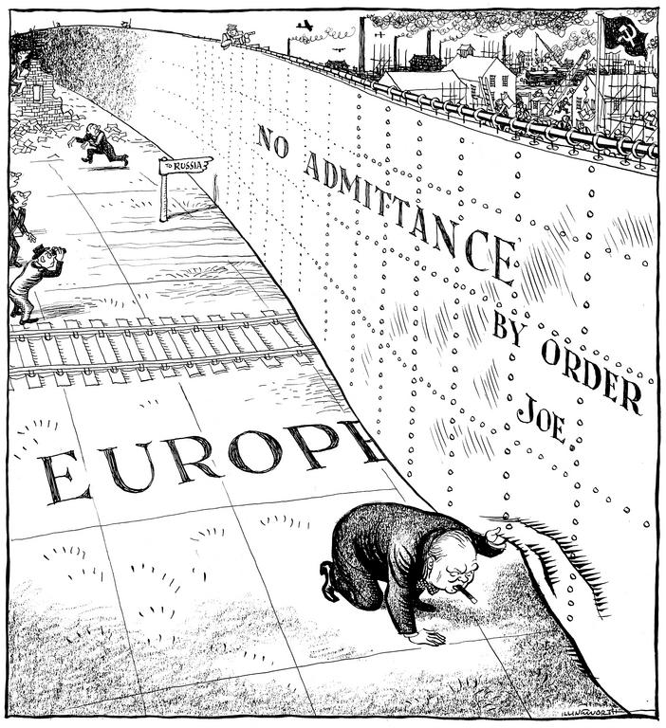
The development of a Cold War, 1945-49
Buffer Zone
Stalin wanted to control Eastern Europe so it would protect the USSR from future invasion
Salami Tactics
The methods used by Stalin to establish communist control in Eastern Europe (eg: rigged elections, crushing opposition)
Iron Curtain
A metaphor for the line that divided Europe between the democratic west and communist east
Containment
The US policy which aimed to stop the spread of communism
Stalin wanted a buffer zone in Eastern Europe to protect USSR from future attacks
The USSR uses the Red Army and salami tactics to take over Eastern Europe ‘slice by slice’
1944-48
Soviet Expansion in Eastern Europe
US diplomat, Kennan, wrote a telegram recommending firm action against the USSR’s expansion in Europe
Soviet ambassador, Novikov, responded with his own telegram accusing the USA of seeking world domination
1946
Long & Novikov Telegrams
Churchill gave a speech in the USA claiming that an ‘Iron Curtain’ now divided Europe.
Stalin saw it as deliberately provocative whilst it also helped to convince Truman of the need to be involved in European affairs
1946
Churchill’s Iron Curtain Speech
The Truman Doctrine was a policy of ‘containment’ – using US influence and resources to stop the spread of communism.
The Marshall Plan gave economic aid to help European countries recover after WW2. They would be less likely to turn to communism.
1947-48
Beginning of US Containment Policy
1947-49
Stalin responded to the Truman Doctrine by tightening his control over Eastern Europe. Cominform was set up in 1947 to coordinate communist party activities across Europe.
Comecon was set up in 1949 to allow the USSR to control the Eastern European economies and take their resources.
Stalin tightens grip over Eastern Europe

Slide 3
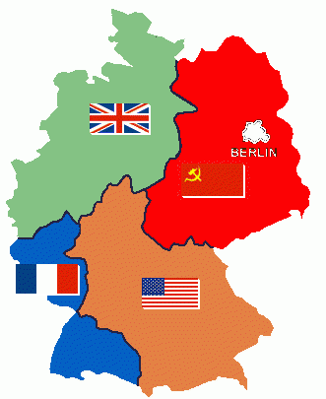
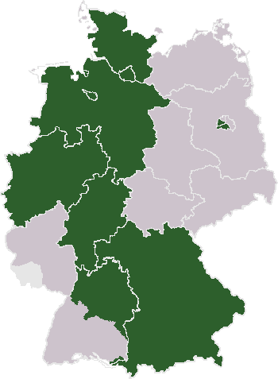
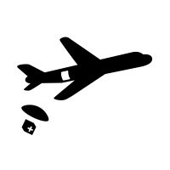
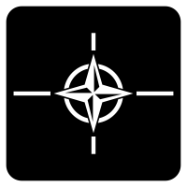
The Berlin Crisis, 1948-49
At Potsdam the Allies agreed to divide Germany and its capital, Berlin, into four zones – American, British, French and Soviet. The idea was to treat Germany as a single economic unit. Differences quickly emerged over how to run the defeated country.
Economic Unit
One country with one currency
Deutsche Mark & Ostmark
The German currencies that replaced the Reichsmark in 1948
Air Corridor
A part of airspace that aircraft must remain in when flying over a certain region
NATO
The North Atlantic Treaty Organisation is an alliance of democratic countries who agree to defend each other against attack
1945
Division of Germany and Berlin
1947
Creation of the Bizone
In January 1947 the British and American zones were merged together to create the ‘Bizone’ – the French zone joined the following year.
1948
Introduction of the Deutsche Mark
In June 1948 the western allies introduced a new currency – the Deutsche Mark – to its zones. The Soviets felt this went against the agreement to treat Germany as a single economic unit.
June 1948
The Berlin Blockade
In response the USSR introduced its own currency – the Ostmark – to the Soviet Zone and cut off road, rail and canal traffic in an attempt to starve West Berlin.
1948-49
The Berlin Airlift
The Allies used the three air corridors to airlift supplies (4600 tons of supplies a day on average) to West Berlin over the following ten months. In May 1949 Stalin backed down.
First direct confrontation between the USA and USSR during Cold War
Confirmed it was impossible to cooperate over Germany – West Germany formed in late May 1949, East Germany formed in Oct
Formation of NATO – US commitment to defence of western Europe
1949
Results of the Crisis

Slide 4
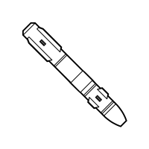
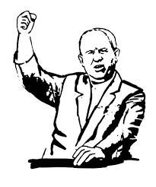
The Arms Race
Arsenal:
A collection of military commitment and weapons.
Deployment:
Distribution of military forces within a given area.
H-bomb (hydrogen bomb)
An explosive weapon of enormous destructive power.
Nuclear weapon:
Highly destructive explosive device that gets it power from nuclear reactions.
NASA (National Aeronautical and Space Administration):
Agency in charge of U.S. science and technology related to airplanes or space.
US drop bombs on Japan to end war.
Soviets respond by tripling scientists’ pay.
1945
USA tested
its first
Atomic Bomb
1949
Truman increases defence spending.
Truman orders building of Hydrogen bomb.
USSR tested
its first
Atomic Bomb
1953
Soviet test just months after US.
US test biggest ever hydrogen bomb on 1st March 1954
(equivalent 15m tons of TNT)
Both develop
Hydrogen
bomb
1957
Eisenhower founded NASA.
Expanded training for scientists and engineers.
US responds by spending on missiles by 20%.
Placed missile bases in Western Europe.
USSR launch
Sputnik
into space.
1959
Both sides have ICBMS
Both sides will recognise the doctrine of Mutually Assured Destruction
Dwight
Eisenhower
1953 - 1960
Josef Stalin
1922-1953
Harry S Truman
1945-1953
Nikita Khrushchev
1953-1964

Slide 5
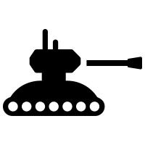
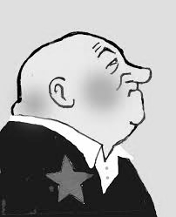
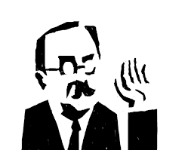
The Hungarian Uprising 1953-56
De-Stalinisation:
Elimination of the influence of Stalin.
Warsaw Pact:
A military treaty and association consisting of the USSR and its European satellite states.
Reform:
To make changes for improvement in order to remove abuse and injustices
Secret police:
A police force that operates in secrecy against people acting against the state.
Liberal Ideas:
A belief in freedom and openness to change.
Rakosi’s rule in Hungary characterised by economic failure and terror.
Moscow orders Rakosi to be replaced by Nagy - a reformer.
1953
Death
of
Josef Stalin
USSR unhappy with liberal policies of Nagy. Replaced by Rakosi.
Increasing tensions with West leads to formation of the Warsaw pact.
1955
Nagy
replaced by
Rakosi
Khrushchev secret speech.
Rakosi forced from power by Moscow.
Nagy proposes reforms to economy, freedom of press, freedom of speech and withdrawal from Warsaw pact.
Student anti-communist protests.
Feb - Oct 1956
Nagy returns
to reform
Hungary
Khrushchev orders Soviet invasion to retake control of Hungary.
USSR appoint Kadar to replace Nagy. Nagy captured and later hung.
Nov 1956
Soviet invasion
restores
control.
Josef Stalin
1922-1953
Matyas Rakosi
1947-53, 55
Imre Nagy
1953-55, 56
Nikita Khrushchev
1953-1964

Slide 6
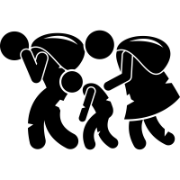
The Berlin Crisis, 1958-63
Refugee problem escalated to 20,000 a month leaving East Berlin for the West.
Khrushchev demands Western allies leave Berlin within 6 months.
1959 Khrushchev visit to USA.
Ultimatum:
A final demand attached to a threat.
Migrate:
To move from one place to another
Brain Drain:
The departure of highly skilled people from a country.
Espionage:
The act of organized spying, usually with the goal of uncovering sensitive military or political information.
Summit:
A meeting between people who are interested in the same subject.
1958
Berlin
Ultimatum
issued.
USSR shoot down U2 spy plane and capture pilot.
Paris summit cancelled after US refuses to apologise.
1960
Paris
Summit
collapses.
Ultimatum repeated at Vienna summit.
JFK refuses. Both sides increase arms spending.
Construction of Wall begins in August.
1961
Construction
of the
Berlin Wall.
Khrushchev claims wall is to protect East Berliners.
Kennedy makes speech to 200,000 in West Berlin ‘Ich bin ein Berliner.’
1963
Kennedy
visits
Berlin.
Nikita Khrushchev
1953-1964
Dwight Eisenhower
1953-1960
John F Kennedy
1960-1963

Slide 7
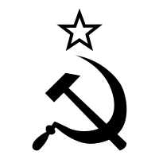
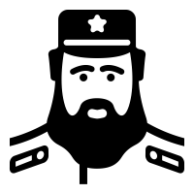
Cuban Revolution and Bay of Pigs, 1959-61
General Batista overthrown by Fidel Castro
USA banned the import of Cuban sugar in response to Castro’s nationalisation of American companies in Cuba
La Brigada 2506
The 1500 Cuban exiles trained by the CIA to invade Cuba.
Bay of Pigs
An inlet on the southern coast of Cuba
CIA
Central Intelligence Agency – the US agency responsible for intelliegence-gathering
Sphere of influence
A region over which one country largely has control or influence
1959
Cuban Revolution
1959-60
Khrushchev, delighted to have an ally close to the USA, offered to buy the Cuban sugar.
Khrushchev also promised to send military assistance
Castro turns to the USSR for help
1500 CIA-trained Cuban exiles (La Brigada 2506) landed at the Bay of Pigs with the aim of toppling Castro.
20,000 men from Castro’s army fought back and defeated La Brigada
1961
Bay of Pigs Invasion
1961-62
Castro declared his conversion to communism
Soviet technicians began to install ballistic missiles
U2 spy plane photographed Soviet missiles on the island of Cuba
Military build-up in Cuba
Nikita Khrushchev
1953-1964
Fidel Castro
1959-2008
John F Kennedy
1960-1963

Slide 8
Cuban Missile Crisis, October 1962
US spy plane photographs reveal Soviet IRBM missiles on Cuba.
JFK convenes ExCom to discuss response options including invasion and airstrikes.
Quarantine:
US navy ships to prevent Soviet ships carrying military equipment to Cuba.
Brinkmanship:
To push a situation to the point of disaster without quite going over the edge.
ICBM:
A nuclear missile capable of being fired from one continent to another.
IRBM:
A nuclear missile capable of reaching Los Angeles from Cuba.
ExCom:
A group of 12 expert advisers created by JFK and led by his brother Robert.
16th - 21st
Missiles
found on
Cuba.
22nd - 24th
JFK announces quarantine of Cuba on television and demands NK remove the missiles.
US armed forces placed on high alert. ICBM response prepared.
Naval
blockade
of Cuba.
NK sends letter offering to remove missiles in return for promise not to invade Cuba.
Second letter adds condition that USA must remove missiles from Turkey.
26th - 27th
Khrushchev’s
two
letters..
US spy plane shot down over Cuba.
JFK accepts second letter and ignores first. Warns invasion if refused.
NK accepts offer. JFK agrees to remove aging Turkish missiles in future.
28th
Deal
ends
crisis.
Nikita Khrushchev
1953-1964
Fidel Castro
1959-2008
John F Kennedy
1960-1963

Slide 9
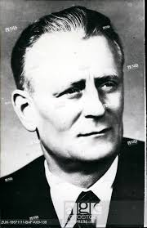
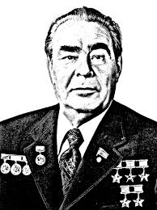
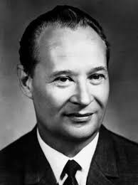
Czechoslovakia & The Prague Spring, 1968 1953-56
De-Stalinisation:
Elimination of the influence of Stalin.
Prague Spring:
A short time in 1968 when the Communist government allowed people to have more freedom than before.
Reform:
To make changes for improvement in order to remove abuse and injustices
Secret police:
A police force that operates in secrecy against people acting against the state.
Brezhnev Doctrine:
A policy which stated the USSR had the right to intervene in places where communism was threatened.
Stalinist ruler Novotny refused to reform and oversaw economic decline.
Dubcek and other reformers appealed to Brezhnev to act.
1967
Rejection
Of
Novotny
Dubcek replaced Novotny and introduces ‘socialism with a human face.’
Reforms to freedom of speech, democracy, secret police, trade unions and travel restrictions (lasted 4 months)
Jan- Aug
1968
Dubcek’s
Prague
Spring.
Closer relations with West Germany and anti-communist protests concerned USSR.
Fellow bloc leaders feared possible withdrawal from Warsaw pact.
Warsaw Pact agrees to Soviet-led invasion, 20th August 1968, 500,000 troops – some opposition – blocking roads and attacking tanks. Dubcek arrested and sent to Moscow.
Aug
1968
Soviet invasion
restores
control.
Brezhnev announced that USSR would suppress any attempt to relax Communist control (stated in Pravda 26th Sept 1968)
USSR appoint Husak – Communist Hardliner, to replace Dubcek. Dubcek resigned and made ambassador to Turkey.
Nov 1968
Brezhnev
Doctrine
Established.
Antonin
Novotny
1953-68
Leonid
Brezhnev
1964-82
Alexander
Dubcek
1968

Slide 10
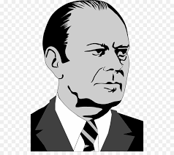
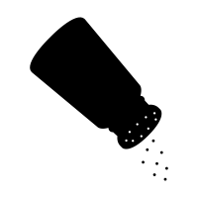
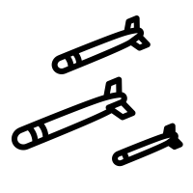
Leonid
Brezhnev
1964-82
Richard
Nixon
1969-74
Gerald
Ford
1974-77
Detente in the 1970s
Cease-fire:
a state of peace agreed to between opponents so they can discuss peace terms
Arms control:
a limitation on the size and armament of the armed forces of a country
Cooperation:
Working together to achieve shared goals.
Helsinki Agreements:
an agreement signed by 35 nations that committed states to fulfill obligations on security, cooperation and human rights.
May 1972
Nixon becomes first President to visit Moscow in 1972.
Arms talks result in SALT I being signed in 1972 limiting production of nuclear weapons.
Arms
Control
Agreements
Oct
1973
Superpowers support opposing sides in Arab-Israeli Yom Kippur War.
Ceasefire agreed through United Nations.
Middle
East
Tensions
July
1974
Nixon visit to Moscow leads to consensus that attempts should be made to further cooperation in all areas.
Second stage of Arms talks begin (concludes with SALT II 1979)
Superpowers
agree mutual
benefits
July
1975
Helsinki Agreements mark commitment to collaborate on international issues with in July 1975.
Apollo-Soyuz mission sees symbolic handshake in space.
Superpowers
lead global
cooperation
Dec 1979
USSR invades Afghanistan to support unpopular communist regime
US condemns the invasion – brings about a Second Cold War
End of detente

Slide 11
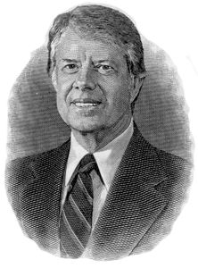
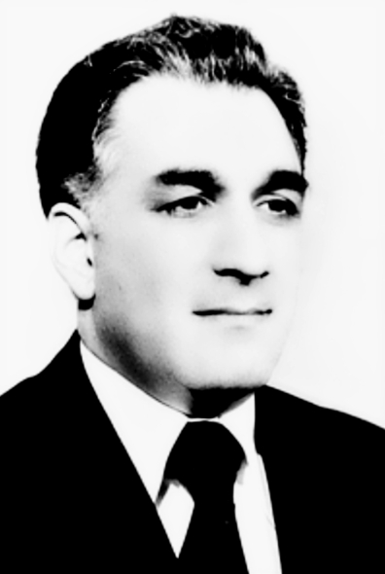
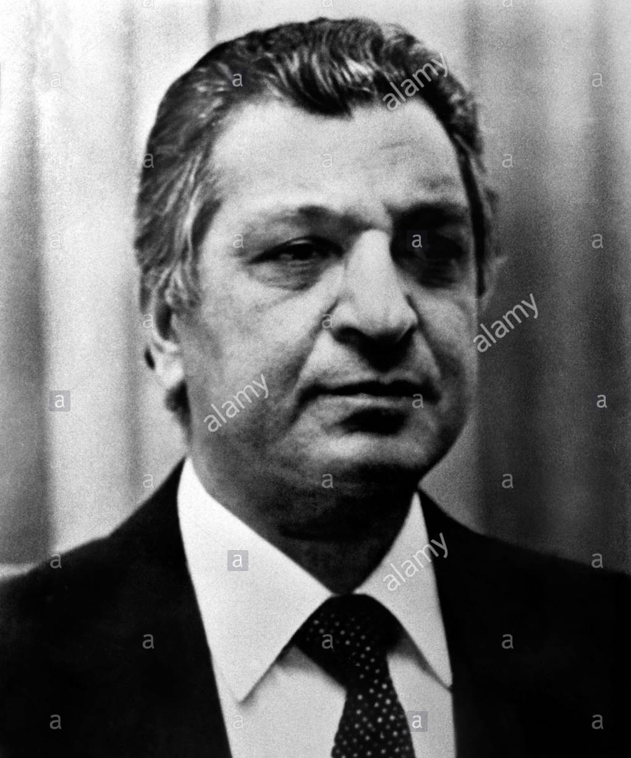
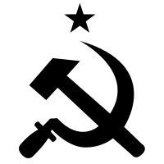
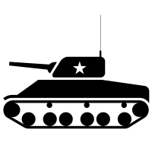
Soviet Invasion of Afghanistan, 1979
Leonid
Brezhnev
1964-82
Jimmy Carter
1977-81
Hafizullah Amin
1979
Babrak Karmal
1979-1986
Fundamentalism
Strictly following a religion or belief
Mujahideen
Islamic rebels who fought against the Afghan communist government
Jihad
Holy war - a struggle or fight against the enemies of Islam
Carter Doctrine
It stated that the USA would use military force if necessary to defend its national interests in the Persian Gulf
Boycott
Abstaining from something in order to protest
1978
In April 1978, Afghan communists seized power and Taraki became Prime Minister of Afghanistan.
Thousands of Islamic religious figures and intellectuals were imprisoned and murdered.
Communists take power in Afghanistan
In September Amin seized power from Taraki but the anti-Muslim policies made the government even more unpopular.
Thousands of Afghan Muslims joined the mujahideen which declared a jihad against Amin and his government. Brezhnev wanted to prove that there would be no changes to the way the USSR was run.
1979
Growth of Islamic fundamentalism
Dec 1979
Soviet Invasion
In late December 1979, 50,000 Soviet troops invaded Afghanistan to prop up the unpopular communist regime.
Amin was executed and replaced by a Soviet puppet leader - Kamal.
Many Afghan soldiers deserted the army to join the mujahideen.
The cost of the invasion for the Soviets was huge - $50bn overall
Jan 1980
The Carter Doctrine is announced
US President Carter was forced to take a tough approach to the USSR so announced the Carter Doctrine.
Carter’s response brought an end to détente.
The US and 61 other countries boycotted the Moscow Olympics in 1980.
Carter asked the US Senate to reject SALT II and then cancelled shipments of grain to the USSR
The USA would train and assist the mujahideen (Operation Cyclone)
Beginning of Second Cold War
1980
End of detente

Slide 12
The Second Cold War, 1980-84
Gerontocracy
Rule by the elderly – this refers to a period in the early 1980s when the USSR was ruled by old and frail leaders
Solidarity
A Polish trade union which was banned in 1982.
Neutron Bomb
A type of nuclear weapon which maximises lethal radiation while minimising the physical power of the blast itself.
Nuclear Utilisation Target Selection (NUTS)
A strategy of bombing the enemy’s missiles, rather than their cities, to destroy their nuclear weapons capabilities.
1979
Soviet Invasion of Afghanistan
In late December 1979, 50,000 Soviet troops invaded Afghanistan to prop up the unpopular communist regime.
1980
Carter’s Response
Carter announced the Carter Doctrine and a host of measures that brought détente to an end, such as the Olympic Boycott (1980) and the refusal to ratify SALT II.
1980
Ronald Reagan won the 1980 election and took a tough line against communism with rhetoric such as calling the USSR an ‘evil empire’.
Reagan increased US military spending to $1trn.
Reagan also gave secret assistance to the Polish trade union, Solidarity
Election of Ronald Reagan
Reagan announced SDI (nicknamed Star Wars) which was a plan for a missile defence system which, using lasers and mirrors, would shield the US from Soviet missiles.
Due to economic and technological barriers, the USSR could no longer compete in the arms race.
1983
Strategic Defence Initiative announced
1980-85
Gerontocracy in the USSR
Soviet leaders Brezhnev, Andropov and Chernenko were all old and frail in the early 1980s. This made it difficult for them to take part in the kind of face-to-face meetings that had allowed détente to occur in the 1970s.

Slide 13
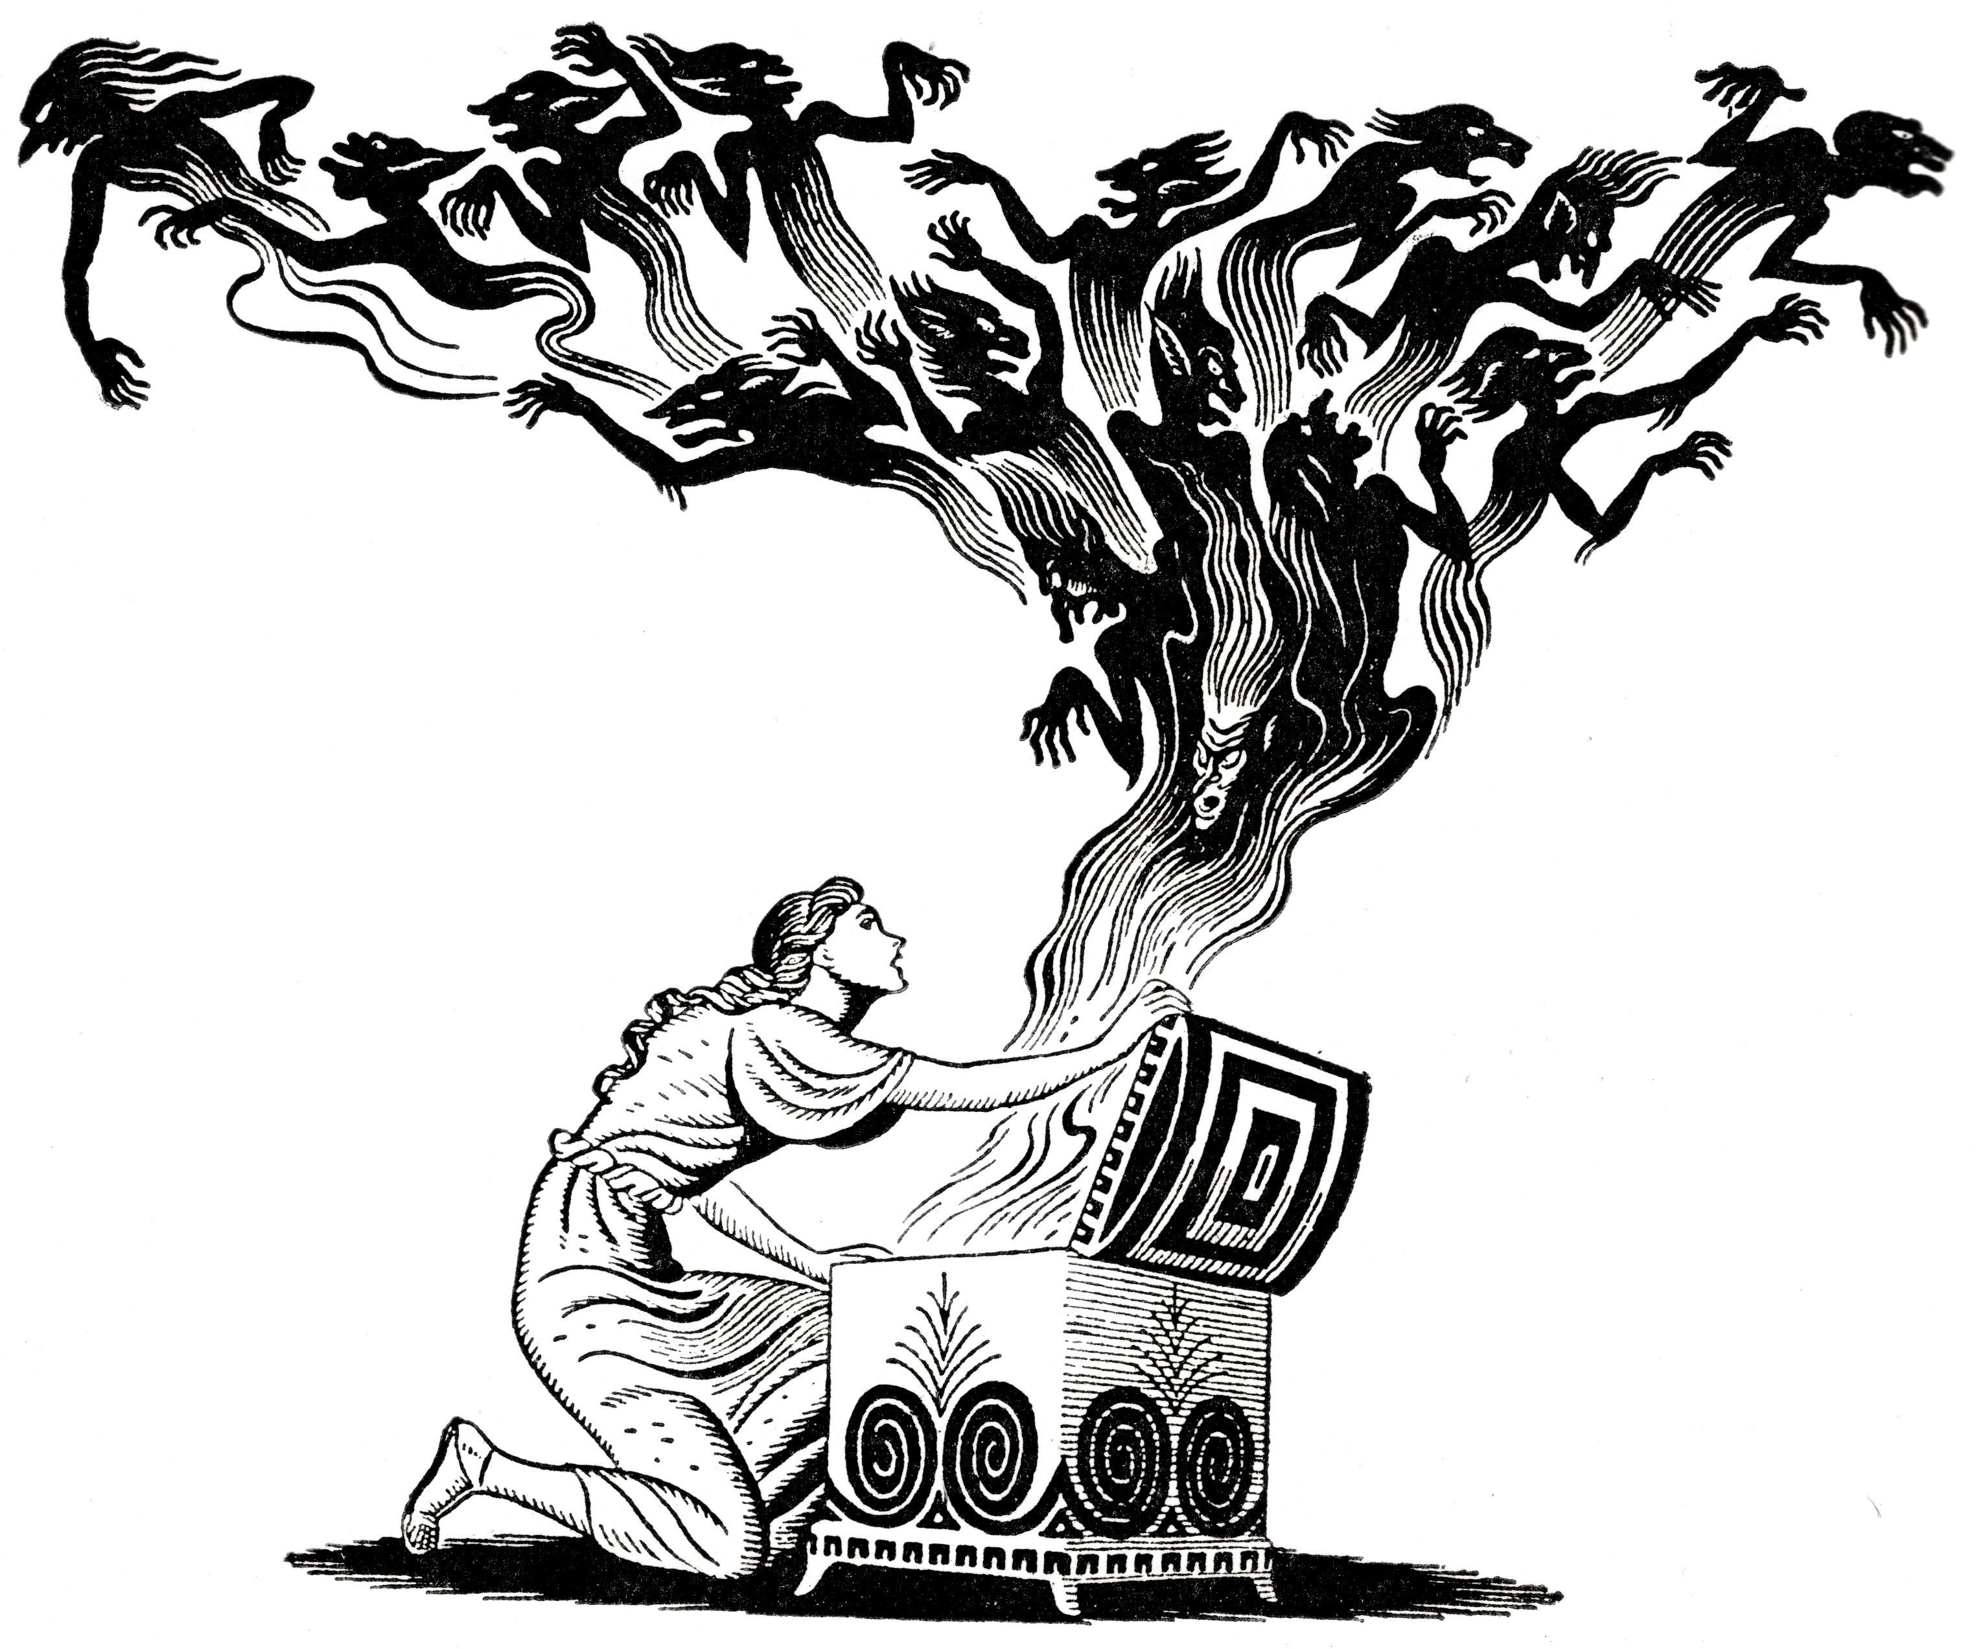
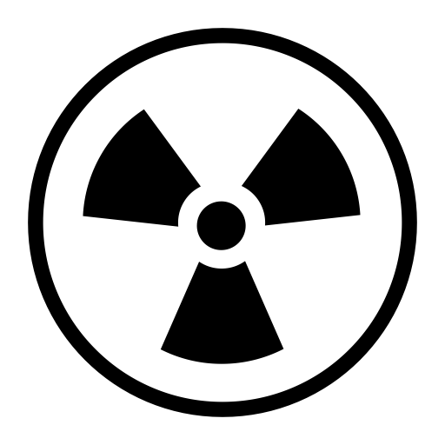
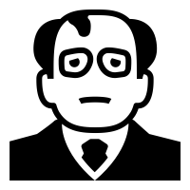
The Impact of Gorbachev’s New Thinking, 1985-90
Glasnost
‘Openness’ – this meant allowing free speech, some elections, and removing some censorship
Perestroika
‘Restructuring’ – this meant making changes to the Communist Party and the Soviet economy
Sinatra Doctrine
The nickname given to Gorbachev’s policy that the USSR would no longer interfere in the affairs of Warsaw Pact countries.
The INF Treaty (1987)
This breakthrough treaty eliminated the intermediate-range class of nuclear weapons. 2700 were destroyed by 1991.
Glasnost meant that dissidents were released from prison and banned books published. This allowed free speech which meant that criticism of Gorbachev, and the Communist Party, could spread.
I want the Soviet Union to survive but we need to save money and improve superpower relations. I have some ideas!
Glasnost (openness) & Perestroika (restructuring)
End the arms race (to save money)
Sinatra Doctrine
A number of summits gradually led to agreements on nuclear weapons. The most significant was the INF Treaty (1987)
Gorbachev rejected the Brezhnev Doctrine and accepted that Warsaw Pact members could make changes without expecting interference.
Mikhail Gorbachev, 1985-91

Slide 14
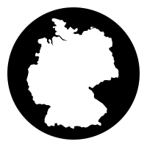
Collapse of Communism in Eastern Europe, 1989
Negotiated Revolutions
This refers to the relatively peaceful revolutions in Poland and Hungary that occurred with the agreement of the ruling communists.
Sinatra Doctrine
The nickname given to Gorbachev’s policy that the USSR would not interfere in the affairs of Eastern Bloc countries anymore.
Two-plus-Four Treaty (1990)
A treaty where the four occupying powers (USA, GB, France and USSR) gave up their rights over Germany allowing it to become a sovereign, reunited nation.
1989
Oct 1989
Nov 1989
1989-90
Oct 1990
Negotiated Revolutions
Sinatra Doctrine Confirmed
Fall of the Berlin Wall
The Rest of the Eastern Bloc Falls
German Reunification
Boldened by Gorbachev’s reforms, Poland held elections with the agreement of the ruling communists. Solidarity won and Mazowiecki became the first non-communist Prime Minister in the Eastern Bloc.
Hungary opened its border with Austria. There was now a hole in the Iron Curtain so many East Germans used this opportunity to flee to the west – the Berlin Wall was now useless.
USSR confirmed that the countries of Eastern Europe could do things ‘their way’ without interference.
Gorbachev had already accepted this informally in 1988.
Events in Hungary made the Berlin Wall obsolete. Huge demonstrations occurred in East Germany (1m people on 4 Nov).
East German government forced to announce greater freedom of travel.
On 9 Nov thousands descended on the border between East and West Berlin and began to dismantle the Berlin Wall.
Over 1m people a day seized the chance to see relatives and friends.
Velvet Revolution – Huge demonstrations against communist rule in Czechoslovakia led to the government’s resignation. Havel became the first non-communist President of Czechoslovakia since 1948. Elections then held.
Romanian army turns on, captures and executes President Ceausescu and his wife. Elections held in 1990.
Bulgaria hold elections in 1990.
With the downfall of the East German government, elections were won by parties promising German reunification.
Eventually a unification treaty was signed and West Germany absorbed the Lander of East Germany on 3 Oct 1990.
Under the Two-Plus-Four Treaty the four victorious powers of the WW2 waived their rights with regard to Germany, thereby granting the Germany full sovereignty.

Slide 15
Dissolution of the USSR, 1990-91
Union of Soviet Socialist Republics (USSR)
The USSR was literally a union of 15 Soviet Socialist Republics – many of which were nations who came to demand independence.
August Coup
The attempt by communist hardliners – the Gang of Eight - to remove Gorbachev form power and undo his reforms
Gorbymania
The enthusiasm in the west for Mikhail Gorbachev following his reforms
Boris Yeltsin
The leader of the Russian part of the USSR, he was instrumental in defeating the August Coup. He later became President of the Russian Federation.
Union Treaty
A treaty that would have re-made the USSR into a country where its members were more equal in power, rather than being dominated by Russia. It was rejected after the August Coup.
1990
Oct 1989
Nov 1989
1989-90
Consequences of Gorbachev’s Policies
Nationalist Demands within the USSR
August Coup
Gorbachev’s Resignation and Dissolution of the USSR
Gorbachev’s willingness to reform made him a hero in the west (Gorbymania).
However leading members of the Communist Party believed that Gorbachev’s ‘new thinking’ had weakened the USSR.
Some of the Soviet Socialist Republics demanded greater independence – could Gorbachev allow the USSR itself to break up?
Having seen Eastern Europe enjoy their freedom, parts of the Soviet Union itself now demanded greater independence.
In 1990, Estonia, Latvia and Lithuania declared independence from the USSR.
Gorbachev now faced pressure from two sides – hardline communists on the one hand, and reformers like Yeltsin on the other.
In August 1991, communist hardliners known as the ‘Gang of Eight’ led an attempted coup against Gorbachev while he was on holiday.
This was defeated by the Russian people led by Boris Yeltsin (Chairman of the Supreme Russian Soviet) who jumped on a tank outside the Soviet building & made a speech to stop the coup.
Gorbachev returned to Moscow but his authority was shattered.
Gorbachev’s final attempt to save the USSR – a new Union Treaty – was rejected by the other republics.
The leaders of the other Soviet republics established a Commonwealth of Independent States (CIS).
On 25 December 1991, Gorbachev resigned and the USSR ceased to exist within a few days. The former republics became independent.

