Slide 1

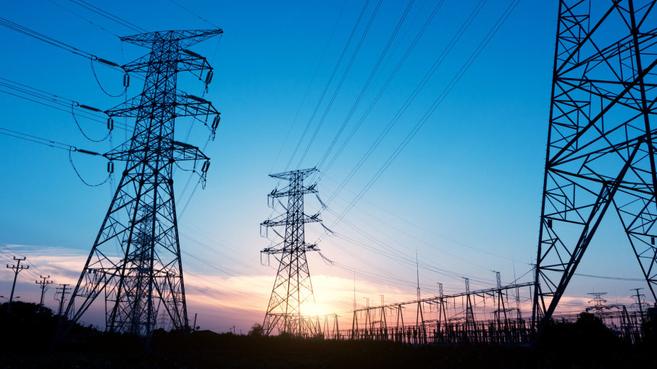



P2 - Electricity
Why are we learning this?
Electricity is all around us--powering technology like our mobile phones, computers, lights and TV’s. It's tough to escape it in our modern world. Even when you try to escape electricity, it's still at work throughout nature, from the lightning in a thunderstorm to the synapses inside our body.
Links to careers:
Electrician
Electrical engineer
Medical equipment engineer
Construction managers
Power Plant operator
Cardiovascular Technologist
Key questions we will answer:
What is an electric current?
How do series and parallel circuits differ?
What is resistance?
How does the electricity we use get to our homes?
I already know… |  | I will learn…
There are two types of electric charge |  | How to calculate the charge flow in an electrical circuit
Potential difference is measured in volts and current is measured in amps |  | How to work out the resistance and potential difference in a circuit
A cell or battery pushes electrons around a circuit |  | How mains electricity differs from electricity supplied by batteries
Power is how much energy is transferred per second |  | How to calculate the power of an electrical device
Links to future learning:
The electricity you use at home is produced by generators in power stations and is used by electric motors in appliances such as washing machines. You will learn how generators and motors work in P7 Magnetism.
In the P7 Magnetism you will also use your knowledge of electricity to be able to explain how motors work (HT only)
Keywords:
Electron, current, charge, series, parallel, Coulomb, Watt, potential difference, amp, volt, resistance, ohm, ohmic conductor, filament lamp, diode, ammeter, voltmeter, thermistor, LDR, alternating current (AC), direct current (DC)

Slide 2
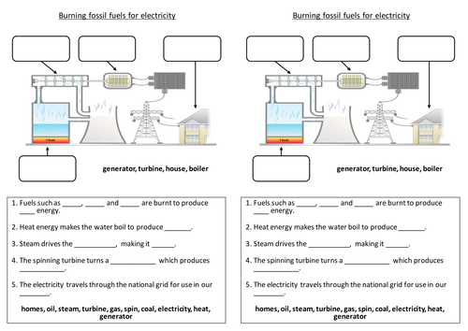
Electrons carry current. Electrons are free to move in metal.
Cell | Battery | Switch | Lamp | Ammeter | Volt meter
Store of chemical energy | Two or more cells in series | Breaks circuit, turning current off | Lights when current flows | Measures current | Measures potential difference
Diode | LED | LDR | Fuse | Resistor | Variable resistor | Thermistor
Current flows one way | Emits light when current flows | Resistance low in bright light | Melts when current is too high | Affects the size of current flowing | Allows current to be varied | Resistance low at high temp
Current | Flow of electrical charge | Ampere (A)
Potential difference (p.d.) | How much electrical work is done by a cell | Volts (V)
Charge | Amount of electricity travelling in a circuit | Coulombs (C)
Circuit symbols
Series and parallel circuits
Series circuit | Current is the same in all components. | Total p.d. from battery is shared between all the components. | Total resistance is the sum of each component’s resistance.
Parallel circuit | Total current is the sum of each component’s current. | p.d. across all components is the same. | Total resistance is less than the resistance value of the smallest individual resistor.
Series | Parallel
A circuit with one loop | A circuit with two or more loops
Current and Charge
Current, potential difference and resistance
Total p.d | If cells are joined in series, add up individual cell values
Charge = Current X time
Q = I X t
Controlling current
Changing current | Change the p.d. of the cells
 | Add more components
Energy transfers
Power (W) = potential difference X current
R = V X I
AQA
Electricity
Work is done when charge flowing.
Power = (current)² X resistance
P = I² X R
Energy transferred = Power X time
E = P X t
Ammeter | Set up in series with components
Voltmeter | Set up parallel to components
R = V ÷ I
Step-up transformers | Step-down transformers
Increase voltage, decrease current | Decrease voltage, increase current
Increases efficiency, reduces heat loss. | Makes safer for houses.
Resistance = Potential difference ÷ Current
Domestic uses and safety
National Grid | Distributes electricity generated in power stations around UK
Resistance (Ω) | A measurement of how much current flow is reduced
The higher the resistance, the more difficult it is for current to flow.
Increasing resistance, reduces current.
Increasing voltage, increases current.
Thermistor | LDR
Resistance varies with temperature | Resistance varies with light intensity
Resistance decreases as temperature increases. | Resistance decreases as light increases.
Alternating current | Direct current
p.d. switches direction many times a second, current switches direction | p.d. remains in one direction, current flows the same direction
Generator. | Cell or battery.
Static electricity
PHYSICS only
Static electricity | Electrical charge is stationary | When two insulating material are rubbed together, electrons move from one material to the other.
Ohmic conductor | At a constant temperature, current is directly proportional to the p.d. across the resistor.
Filament lamp | As current increases, the resistance increases. The temperature increases as current flows.
Diode | Current flows when p.d. flows forward. Very high resistance in reverse.
‘Earthing’ a safety device; Earth wire joins the metal case.
Mains supply
Frequency 50Hz, 230V
Current – Potential difference graphs
Like charges | Repel
Unlike charges | Attract
Shocks | Walking on carpet causes friction. Electrons move to the person and charge builds up. When the person touches a metal object, the electrons conduct away, making a spark.
3 pin plug | Live - Brown | Carries p.d from mains supply. | p.d between live and earth = 230V
 | Neutral - Blue | Completes the circuit. | p.d. = OV
 | Earth – Green and Yellow stripes | Only carries current if there is a fault. | p.d. = 0V
Electric fields | Charged objects create electric fields around them. Strongest closest to the object. The field direction is the direction of force on a positive charge. Add more charge increases field strength.

