Slide 1

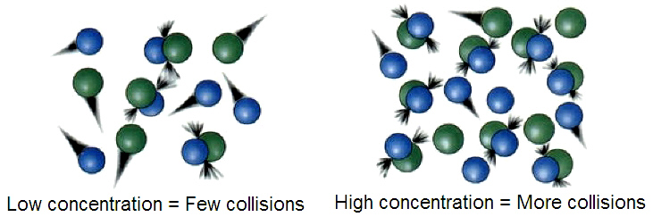



C6 – The Rate and Extent of
Chemical Change
Why are we learning this?
In industry, chemists and chemical engineers determine the effect of different variables on reaction rate and yield of product to ensure that enough product is produced within a sufficient time, and in an energy-efficient way. If they didn’t do this, products would be more expensive.
Links to careers:
Chemicals and
Energy engineer
Materials developer
Product Designer
Jet fuel analyst
Key questions we will answer:
How can we speed up and slow down the rate of chemical reactions?
What part do catalysts play in speeding up the rate of reaction?
What is dynamic equilibrium (HT only)?
I already know… |  | I will learn…
The properties of different states of matter in terms of the particles model |  | How to apply the particles model in the collision theory used to explain the effect of changing conditions on the rate of reaction
What catalysts do |  | to explain how catalysts can affect the rate of reaction in terms of their effect on the activation energy
That some chemical reactions are reversible |  | Use Le Chatelier’s Principle to predict the effect of a change in the conditions on chemical equilibria (HT only)
Links to future learning:
The compromise between the rate of reaction and high yields in industrial processes that use reversible reactions are covered in the C10 Using Resources unit. You will also look at the importance of reducing the rate of iron and steel rusting.
You will use this knowledge when looking at factors affecting the rate of photosynthesis in the B4 Bioenergetics unit
Keywords:
Rate of reaction, chemical reaction, temperature, surface area, pressure, concentration, collision theory, particle, atoms, kinetic energy, activation energy, catalyst, reversible reaction, dynamic equilibrium, Le Chatelier’s Principle,

Slide 2
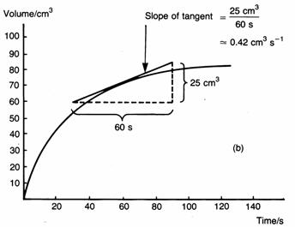
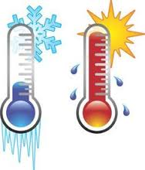
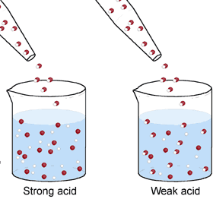
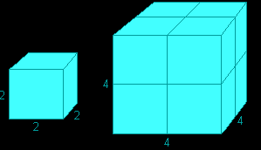
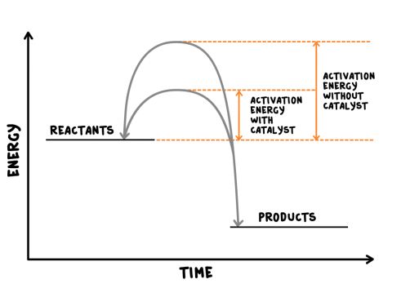
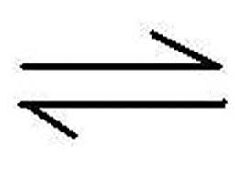
Rate of chemical reaction | This can be calculated by measuring the quantity of reactant used or product formed in a given time. | Rate = quantity of reactant used time taken Rate = quantity of product formed time taken
Factors affecting the rate of reaction
Temperature | The higher the temperature, the quicker the rate of reaction.
Concentration | The higher the concentration, the quicker the rate of reaction.
Surface area | The larger the surface area of a reactant solid, the quicker the rate of reaction.
Pressure (of gases) | When gases react, the higher the pressure upon them, the quicker the rate of reaction.
Quantity | Unit
Mass | Grams (g)
Volume | cm³
Rate of reaction | Grams per cm³ (g/cm³) HT: moles per second (mol/s)
Calculating rates of reactions
Factors affecting rates
Rate of reaction
Collision theory and activation energy
AQA GCSE
The rate and extent of chemical change
Catalyst | A catalyst changes the rate of a chemical reaction but is not used in the reaction.
Enzymes | These are biological catalysts.
How do they work? | Catalysts provide a different reaction pathway where reactants do not require as much energy to react when they collide.
Collision theory | Chemical reactions can only occur when reacting particles collide with each other with sufficient energy. | Increasing the temperature increases the frequency of collisions and makes the collisions more energetic, therefore increasing the rate of reaction. Increasing the concentration, pressure (gases) and surface area (solids) of reactions increases the frequency of collisions, therefore increasing the rate of reaction.
Activation energy | This is the minimum amount of energy colliding particles in a reaction need in order to react.
Catalysts
If a catalyst is used in a reaction, it is not shown in the word equation.
Reversible reactions and dynamic equilibrium
Reversible reactions
Reversible reactions | In some chemical reactions, the products can react again to re-form the reactants.
Representing reversible reactions | A + B C + D
The direction | The direction of reversible reactions can be changed by changing conditions: heat A + B C + D cool
Changing conditions and equilibrium (HT)
Le Chatelier’s Principles | States that when a system experiences a disturbance (change in condition), it will respond to restore a new equilibrium state.
Changing concentration | If the concentration of a reactant is increased, more products will be formed . If the concentration of a product is decreased, more reactants will react.
Changing temperature | If the temperature of a system at equilibrium is increased: Exothermic reaction = products decrease Endothermic reaction = products increase
Changing pressure (gaseous reactions) | For a gaseous system at equilibrium: Pressure increase = equilibrium position shifts to side of equation with smaller number of molecules. Pressure decrease = equilibrium position shifts to side of equation with larger number of molecules.
Equilibrium
The relative amounts of reactants and products at equilibrium depend on the conditions of the reaction.
Equilibrium in reversible reactions | When a reversible reaction occurs in apparatus which prevents the escape of reactants and products, equilibrium is reached when the forward and reverse reactions occur exactly at the same rate.
Energy changes and reversible reactions
If one direction of a reversible reaction is exothermic, the opposite direction is endothermic. The same amount of energy is transferred in each case.
For example: _{endothermic}
Hydrated copper Anhydrous copper + Water
sulfate ^{exothermic} sulfate

