Slide 1

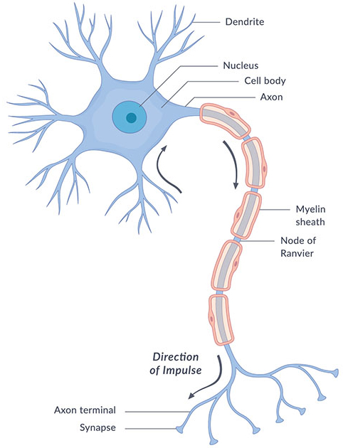
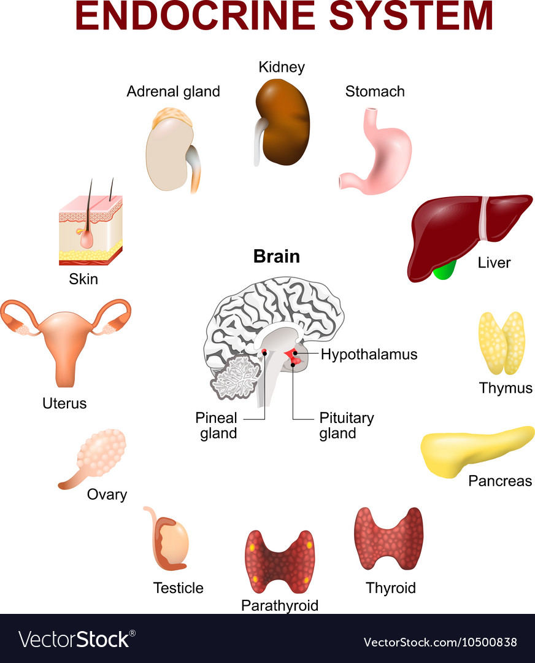



B5 – Homeostasis and Response
Why are we learning this?
The ability to respond to the world around you is the key to survival. We will learn about the need for awareness of the conditions outside and inside your body to coordinate your responses and maintain a stable environment for your cells to function.
Links to careers:
Neuroscientist
Audiologist
Optician
Doctor
Neural engineer
Diabetes nurse
Key questions we will answer:
What is homeostasis and why is it important?
Why are reflex actions so important for survival?
How do hormones control responses to changes in our surrounding?
I already know… |  | I will learn…
The basic structure of neurones |  | The differences between sensory and motor neurones and their roles in coordination and control
That tissues can be organised into organs with particular functions in the body |  | About the arrangement of tissues in the human eye and how they are adapted to their functions (seps only)
The basic process of human reproduction |  | How reproduction is controlled by hormones and how hormones can be used in the artificial control of fertility
How the rate of enzyme action is affected by temperature changes |  | How body temperature is maintained within a narrow range through the process of homeostasis
Links to future learning:
You have already learnt about the specialised cells and tissues that are important in the nervous and hormonal response of animals
You will learn more about the adaptations of organisms to maintain homeostasis in challenging environments in the “B7 Ecology” unit
Keywords:
Homeostasis, nervous system, endocrine system, hormone, sensory, relay, motor, neurone, neurotransmitter, synapse, reflex, effector, adrenaline, thyroxine, thermoregulatory centre, hypothalamus, pancreas, insulin, diabetes, vasoconstriction, vasodilation, pituitary gland

Slide 2
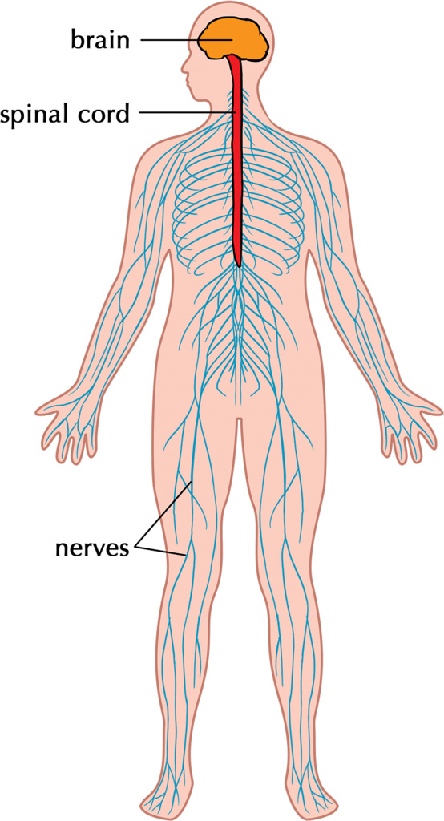
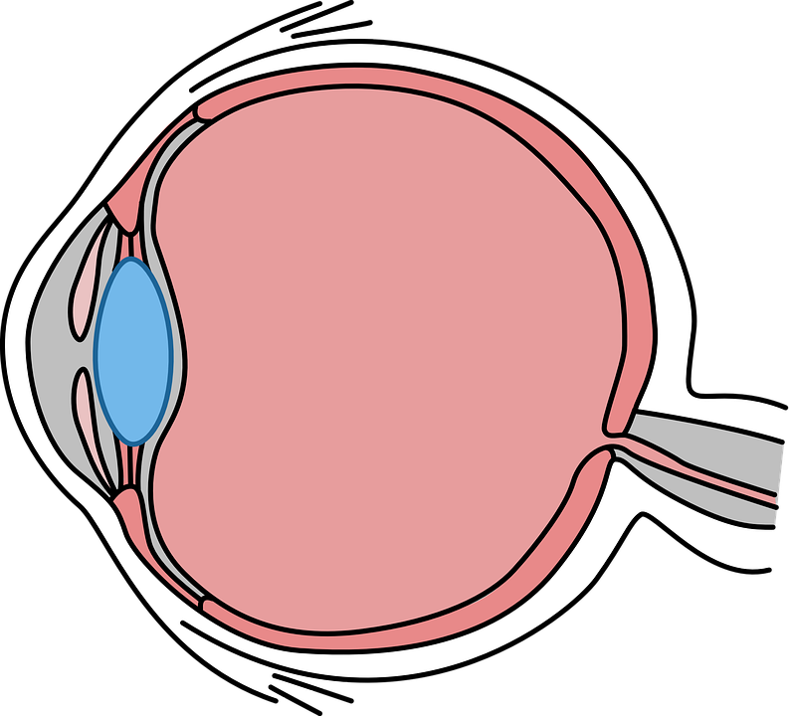
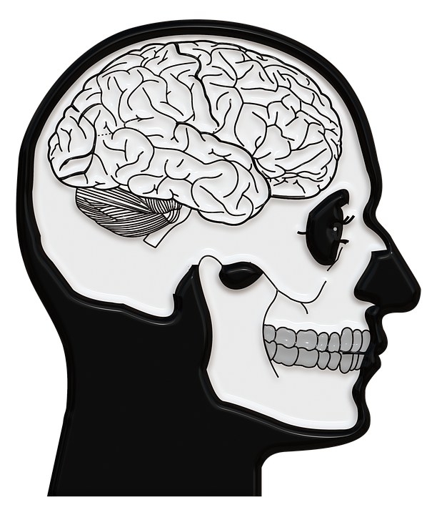
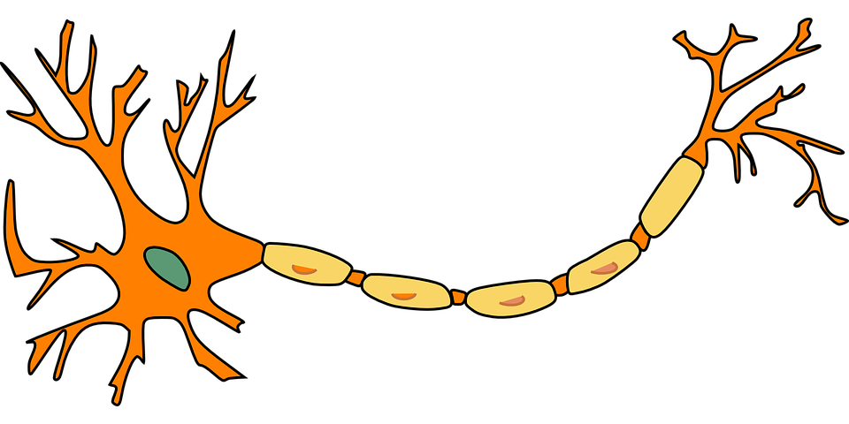
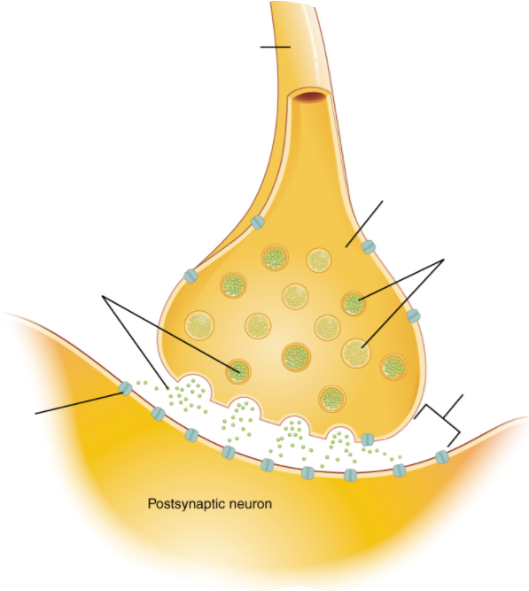
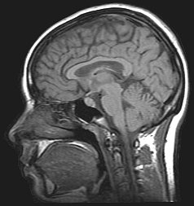
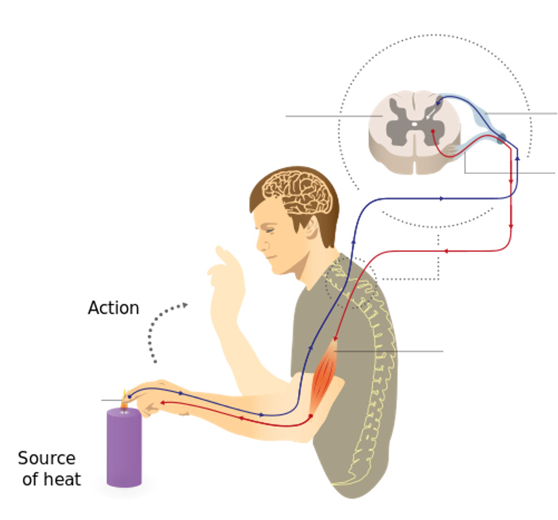
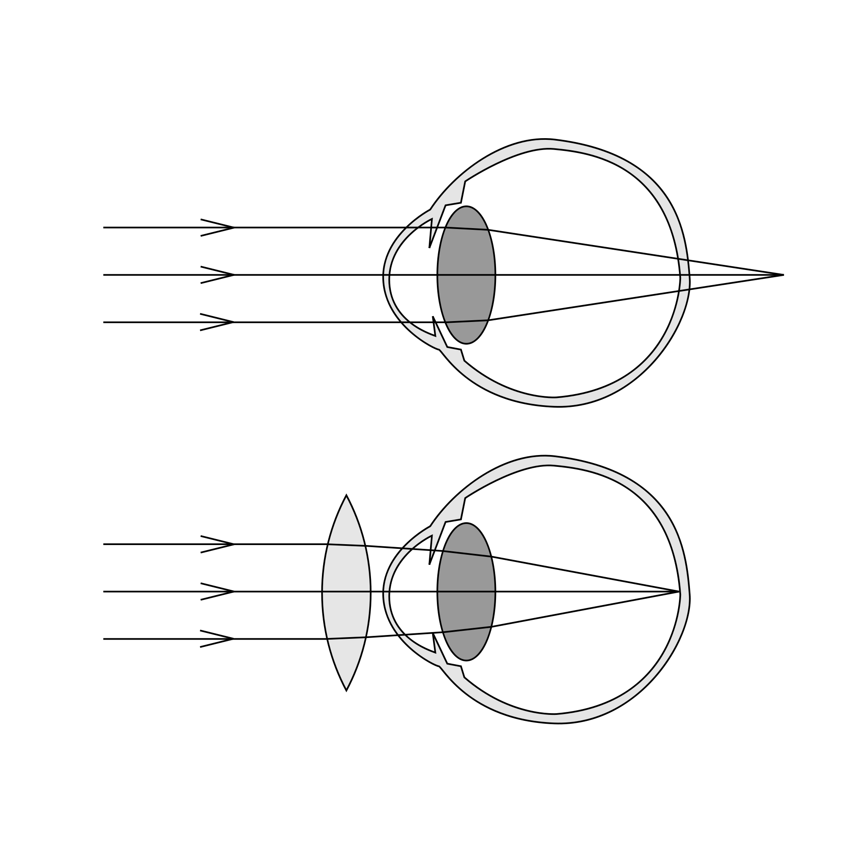
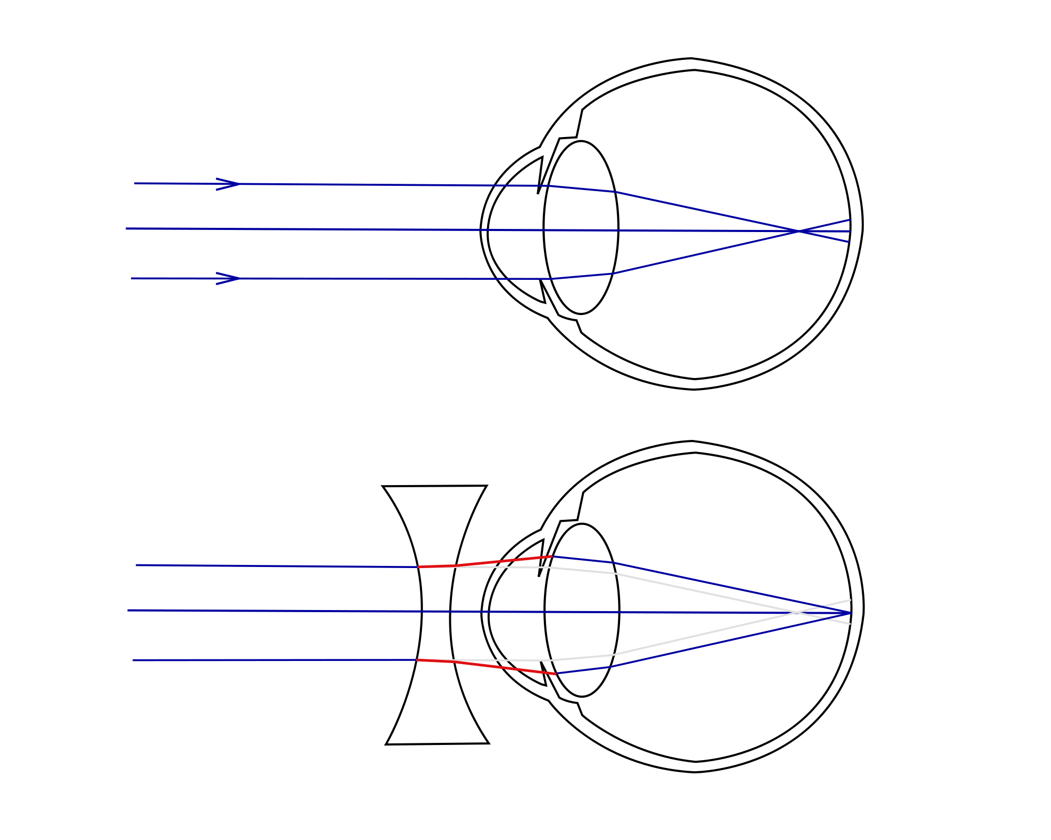
The iris can dilate the pupil (aperture) to let in more light in dim conditions
Sense organ containing receptors sensitive to light intensity and colour
Human control systems include | Cells called receptors | Detect stimuli (changes in environment).
 | Coordination centres | e.g. brain, spinal cord and pancreas that receive information from receptors.
 | Effectors | Muscles or glands, which bring about responses to restore optimum levels.
Enables humans to react to their surroundings and to co-ordinate their behaviour
Structures of the eye | Retina | Light sensitive cell layer.
 | Optic nerve | Carries impulse to brain.
 | Sclera | Protects the eye.
 | Cornea | Transparent layer that covers the pupil and iris.
 | Iris | Pigmented layer, controls size of pupil.
 | Ciliary muscles | Controls thickness of lens.
 | Suspensory ligaments | Connects lens to ciliary muscles.
Information from receptors passes along cells (neurones) as electrical impulses to the central nervous system (CNS)
The CNS is the brain and the spinal cord.
Coordinates the response of effectors; muscles contracting or glands secreting hormones
Stimulus | Lights switch on
Receptor | Cells in retina
Coordinator | CNS
Effector | Muscles connected to iris
Response | Pupils get smaller
The Eye (Bio only)
AQA GCSE HOMEOSTASIS AND RESPONSE part 1
The human nervous system
suspensory ligament
sclera
cornea
retina
optic nerve
cerebral cortex
iris
The Brain (Bio only)
dendrites
ciliary muscles
cerebellum
The brain controls complex behaviour. It is made of billions of interconnected neurones.
cell body
Neuroscientists have been able to map regions of the brain by studying patients with brain damage, electrical stimulation and MRI.
axon terminal
Accommodation is the process of changing the shape of the lens to focus
Near object | Far object
Ciliary muscles contract, suspensory ligaments loosed, lens get thicker, light is more refracted. | Ciliary muscles relax, suspensory ligaments pulled tight, lens pulled thin, light is only slightly refracted.
medulla
nucleus
axon with insulating sheath
The brain has different regions that carry out different functions. | Cerebral cortex | Largest part of the human brain. Higher thinking skills e.g. speech, decision making.
 | Cerebellum | Balance and voluntary muscle function e.g. walking, lifting.
 | Medulla | Involuntary (automatic) body functions e.g. breathing, heart rate.
Typical motor neurone
Synapse (gap where two neurones meet).
(HT) The complexity and delicacy of the brain makes investigating and treating brain disorders very difficult
axon
direction of impulse
axon terminal
neurotransmitter
vesicles
Hyperopia (long sightedness) | Myopia (short sightedness)
Treated using a convex lens so the light is focused on the retina. | Treated using a concave lens so light is focused on the retina.
neurotransmitter
receptors
Synaptic cleft
spinal cord
sensory neurone
Treating brain damage and disease | e.g. Lobotomy – cutting part of the cerebral cortex | Benefit: thought to alleviate the symptoms of some mental illnesses.
 |  | Risks: bleeding in the brain, seizures, loss of brain function. Procedure was abandoned in the 1950s due to risk.
Reflex arc | Receptor | Detect stimuli.
 | Sensory neurone | Long axon carries impulse from receptor to spinal cord.
 | Synapse | Gap where neurones meet. Chemical message using neurotransmitter.
 | Relay neurone | Allows impulses to travel between sensory and motor neurones in the spinal cord.
 | Motor neurone | Long axon carries impulse from receptor to effector.
 | Effector | Muscle or gland that carries out response.
motor neurone
pain receptors
muscle (effector)
Reflex actions are automatic and rapid; they do not involve the conscious part of the brain and can protect humans from harm.
New technologies now include hard/soft contact lens, laser surgery to change the shape of the cornea and a replacement lens in the eye.

Slide 3
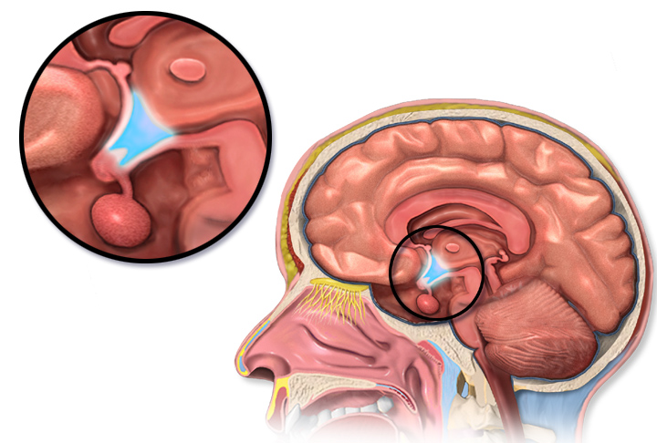
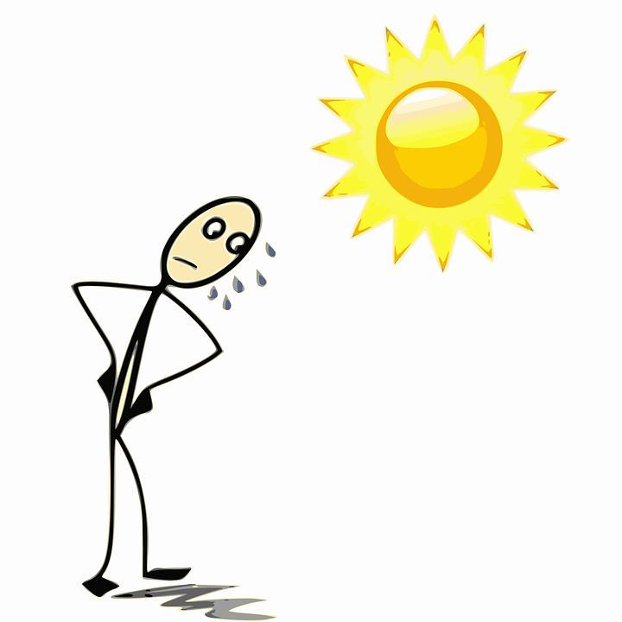

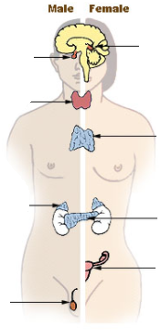
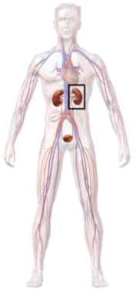
Controls in the human body | Blood glucose concentration | These automatic control systems may involve nervous responses or chemical responses.
 | Body temperature
 | Water levels
Monitoring body temperature | Thermoregulatory centre | Contains receptors sensitive to the temperature of the blood.
 | Skin | Contains temperature receptors, sends nervous impulses to the thermoregulatory centre.
Body temperature | Too high | Blood vessels dilate (vasodilation), sweat produced from sweat glands.
 | Too low | Blood vessels constrict (vasoconstriction), sweating stops, muscles contract (shivering).
Thermoregulatory centre (hypothalamus)
(HT) Thermal energy is lost from blood near the surface of the skin, sweat evaporates transferring thermal energy.
Response to internal and external change
The regulation of internal conditions of a cell or organism to maintain optimum conditions for function.
Control of body temperature
(Biology only)
(HT) Thermal energy loss at the surface of the skin is reduced, respiring muscles cells transfer chemical to thermal energy.
Homeostasis maintains optimal conditions for enzyme action and all cell functions.
Human endocrine system
Endocrine system | Composed of glands which secrete chemicals called hormones directly into the bloodstream. | The blood carries the hormone to a target organ where is produces an effect. Compared to the nervous system effects are slower but act for longer.
Homeostasis
AQA GCSE HOMEOSTASIS AND RESPONSE PART 2
Pituitary
gland
Pineal
gland
Thyroid
Water and nitrogen balance
(Biology only)
Thymus
Adrenal
gland
Pituitary gland | ‘Master gland’; secretes several hormones into the blood | Stimulates other glands to produce hormones to bring about effects.
If body cells lose or gain too much water by osmosis they do no function efficiently. | Uncontrolled water/ion urea loss | Water exhaled in lungs, water, ions and urea in sweat.
 | Controlled water/ion/urea loss | Via the kidneys in urine.
Control of blood glucose concentration
Pancreas
Ovaries
Testes
Blood glucose concentration
Monitored and controlled by the pancreas
Too high | (HT only) Too low
Pancreas produces the hormone insulin, glucose moves from the blood into the cells. In liver and muscle cells excess glucose is converted to glycogen for storage. | Pancreas produces the hormone glucagon that causes glycogen to be converted into glucose and released into the blood.
Negative feedback (HT only) | Adrenaline | Produced in adrenal glands, increases breathing/heart rate, blood flow to muscles, conversion glycogen to glucose. Prepares body for ‘fight or flight’.
 | Thyroxine | Produced in the thyroid gland, stimulates the basal metabolic rate. Important in growth and development.
Kidney failure is treated by organ transplant or dialysis.
(HT only) digestion of proteins results in excess amino acids. In the liver they are de-aminated to form toxic ammonia which is converted to urea
A dialysis machine removes urea from the blood by diffusion while maintaining ion and glucose levels.
Kidney function | Maintain water balance of the body. | Produce urine by filtration of the blood and selective reabsorption of glucose, ions and water.
(HT) Rising glucose levels inhibit the release of glucagon in a negative feedback system. Insulin is released to reduce glucose levels and which cause the pancreas to release glucagon
Increasing thyroxine levels prevent the release of thyroid stimulating hormone which stops the release of thyroxine.
Diabetes
Type 1 | Type 2
Pancreas fails to produce sufficient insulin leading to uncontrolled blood glucose levels. Normally treated by insulin injection. | Obesity is a risk factor. Body cells no longer respond to insulin. Common treatments include changing by diet and increasing exercise.
(HT only) ADH | Acts on kidney tubules to control water levels. | Released by pituitary gland when blood is too concentrated. Water is reabsorbed back into the blood from the kidney tubules (NEGATIVE FEEDBACK).

Slide 4
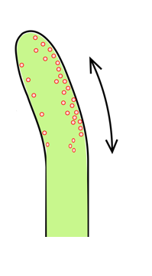

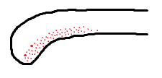
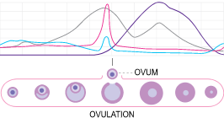
FSH and LH are used as ‘fertility drugs’ to help someone become pregnant in the normal way
Plant responses using hormones (auxins) | Light (phototropism) | Light breaks down auxins and they become unequally distributed in the shoot. The side with the highest concentration of auxins has the highest growth rate and the shoot grows toward the light.
 | Gravity (geotropism or gravitropism) | Gravity causes an unequal distribution of auxins. In roots the side with the lowest concentration has the highest growth rate and the root grows in the direction of gravity.
 |  | In new shoots from a seedling the unequal distribution of auxins causes the shoot to grow away from gravity.
In Vitro Fertilisation (IVF) treatment.
Involves giving a mother FSH and LH to stimulate the maturation of several eggs
The eggs are collected from the mother and fertilised by sperm from the father in a laboratory.
The fertilised eggs develop into embryos.
At the stage when they are tiny balls of cells, one or two embryos are inserted into the mother’s uterus (womb).
Plants produce hormones to coordinate and control growth
Hormones are used in modern reproductive technologies to treat infertility
Light
gravity
(HT only) Gibberellins are important in initiating seed germination.
(HT only) Ethene controls cell division and ripening of fruits.
The use of hormone to treat infertility (HT only)
Plant growth hormones are used in agriculture and horticulture | Auxins | Weed killers, rooting powders, promoting growth in tissue culture.
 | Ethene | Control ripening of fruit during storage and transport.
 | Gibberellins | End seed dormancy, promote flowering, increase fruit size.
Plant hormones
Use of plant hormones (BIO HT only)
Potential disadvantages of IVF | Emotional and physical stress.
 | Success rates are not high.
 | Multiple births risk to mother and babies.
AQA GCSE HOMEOSTASIS AND RESPONSE PART 3
Hormones in human reproduction
Pituitary
gland
Pineal
gland
Contraception
During puberty reproductive hormones cause secondary sexual characteristics to develop
Oestrogen (main female reproductive hormone) | Testosterone (main male reproductive hormone)
Produced in the ovaries. At puberty eggs being to mature releasing one every 28 days – ovulation. | Produced in the testes stimulation sperm production.
Thyroid
Fertility can be controlled by hormonal and non hormonal methods | Oral contraceptives | Contain hormones to inhibit FSH production so that no eggs mature.
 | Injection, implant, skin patch | For slow release of progesterone to inhibit the maturation and release of eggs for months or years.
 | Barrier methods | Condoms or diaphragms which prevent sperm reaching the egg.
 | Intrauterine devices | Prevent implantation of an embryo or release a hormone.
 | Spermicidal agents | Kill or disable sperm.
 | Abstaining | Avoiding intercourse when an egg may be in the oviduct.
 | Surgery | Male or female sterilisation.
Thymus
Adrenal
gland
Pancreas
Ovaries
(HT only) a graph of hormone levels over time
Testes
oestrogen
progesterone
Menstrual cycle | Follicle stimulating hormone (FSH) | Causes maturation of an egg in the ovary. | (HT) FSH stimulates ovaries to produce oestrogen.
 | Luteinising hormone (LH) | Stimulates release of an egg. | (HT) Oestrogen stops FSH production and stimulates LH production in pituitary gland.
 | Oestrogen and progesterone | Maintain uterus lining.
FSH
LH

